Slide 1
Digital Lithological Mapping using Hyper Spectral Images
January 2024
Bellairs Workshop 2024
Lakshitha Ramanayake
Department of Electrical and Computer Engineering
Rutgers University–New Brunswick
www.inspirelab.us

Slide 2
The work presented is based on
Ramanayake, R & Fernando, Dilum & Wickramasinghe, Nipun & Ranasinghe, Don Yasiru & Godaliyadda, G M Roshan & Herath, Vijitha & Ekanayake, Mervyn Parakrama & Senaratne, Atula & Kizel, Fadi. (2023). A Novel Algorithm for Digital Lithological Mapping: Case Studies in Sri Lanka's Mineral Exploration. 10.13140/RG.2.2.16744.85768.
Under the guidance and supervision of

Slide 3
OUTLINE
Introduction
Algorithm Development
Image Acquisition and Preprocessing
Detection and Isolation of Macroscopical Components
Sub-Class Identification
Soil Pixel Alignment and Abundance Map Generation
Case Studies in Sri Lanka’s Mineral Exploration
Notes:
Intro to – Lithological. Mapping, HSI

Slide 4
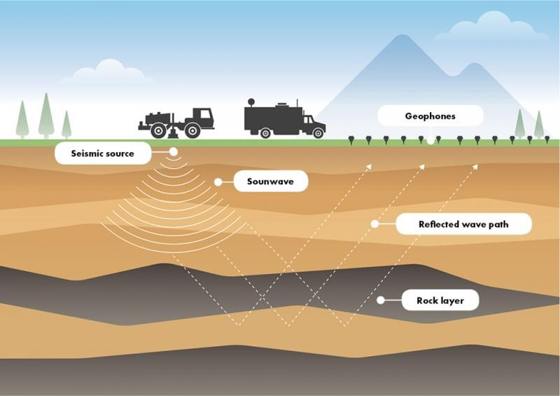
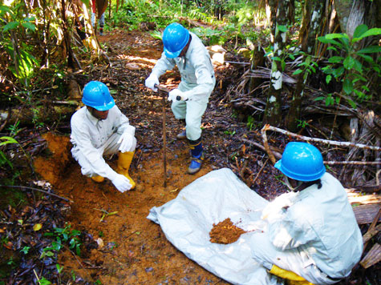
Introduction
Lithological Mapping
“Process of identifying, classifying, and mapping different rock types within a specific geological area to understand its subsurface composition and geological history.”
Conventional Method:
Geological mapping
Geochemical sampling
Geophysical survey
Image: Google Search “Lithological Mapping ”
Notes:
Lithological Mapping: Identifying and mapping the presence of a particular mineral in a particular geographical landscape.
Geological Mapping: Field-based mapping of rock formations and structures.
Geochemical Sampling: Collecting and analyzing soil, water, or rock samples for trace elements indicative of mineralization.
Geophysical Surveys: Using techniques like magnetic, gravity, and seismic surveys to detect subsurface anomalies.
Drilling: Core or rotary drilling to obtain physical samples from depth.

Slide 5
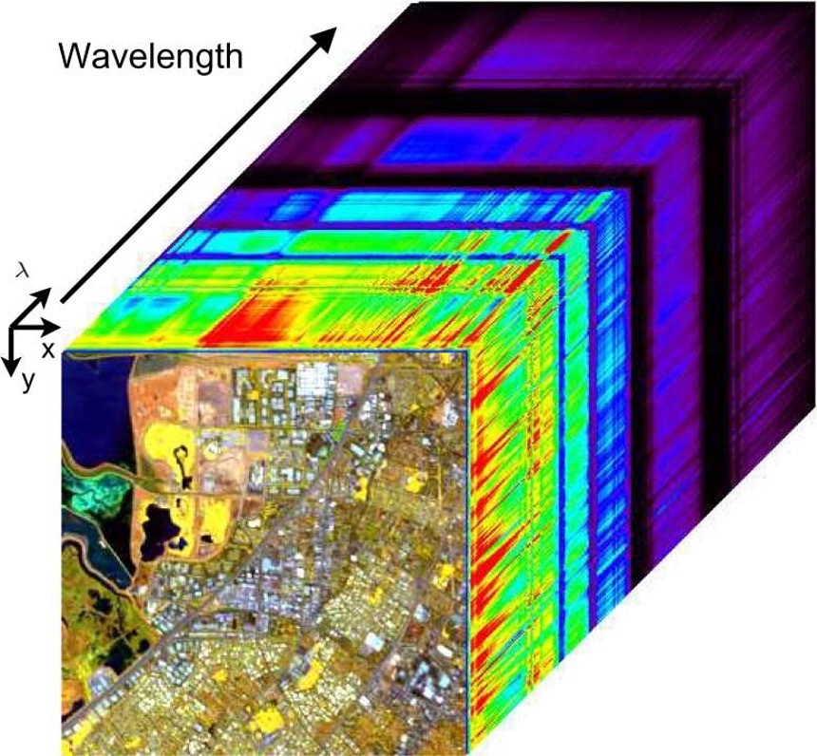
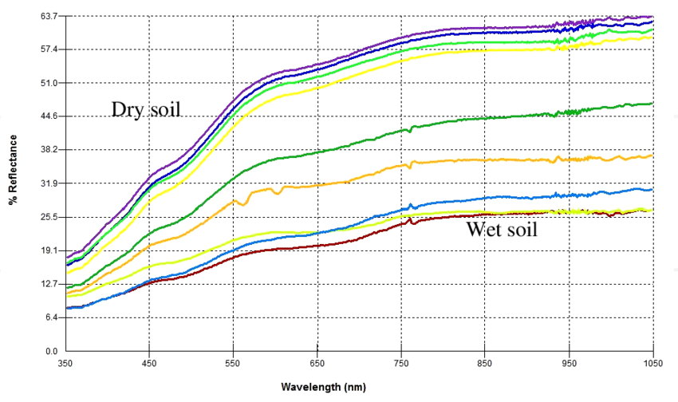
Introduction
Hyper Spectral Imaging (HSI)?
“Hyper-spectral imaging moves beyond three-colour capture, breaking down the spectrum into narrow bands.”
Benefits of Hyper Spectral Imaging
Improved Analysis: The detailed spectral information facilitates in-depth analysis and identification.
Enhanced Discrimination: HSI allows for the differentiation of materials that may appear similar in traditional imaging.
Versatility: Applicable across various domains, HSI proves valuable in diverse fields.
Images : Google
Notes:
Imaging narrow spectral bands over a continuous spectral range.
Light – dark – Bright sand to dark loamy soil
Each band corresponds to a specific wavelength, enabling precise material identification based on unique spectral signatures.

Slide 6
Related Work
The use of Multi-Spectral Images:
Adiri, Zakaria, et al. "Lithological mapping using Landsat 8 OLI and Terra ASTER multispectral data in the Bas Drâa inlier, Moroccan Anti Atlas." Journal of Applied Remote Sensing 10.1 (2016): 016005-016005.
2. Band Ratioing:
Gad, Sabreen & Kusky, Timothy. (2007). ASTER spectral rationing for lithological mapping in the Arabian–Nubian shield, the Neoproterozoic Wadi Kid area, Sinai, Egypt. Gondwana Research. 11. 326-335. 10.1016/j.gr.2006.02.010.
3. Hyperspectral Unmixing:
Mehr, Saeed Goodarzi, et al. "Using unmixing methods to classify lithological and alteration units based on hyperspectral images." Jour. Tethys 1.1 (2013): 1-11.
4. Machine Learning Approaches:
El-Omairi, Mohamed Ali, and Abdelkader El Garouani. "A review on advancements in lithological mapping utilizing machine learning algorithms and remote sensing data." Heliyon (2023).
Notes:
Band Ratio:
Ratio between bands which are sensitive to the specific materials that they are interested in.
Technique in which reflectance values in one spectral band are divided from the corresponding values in another band.
Hyperspectral Unmixing:
Decomposes the measured pixel spectrum of hyperspectral data into a collection of constituent spectral signatures (or endmembers) and a set of corresponding fractional abundances.
Machine Learning:
Random Forest, Support Vector Machines, Artificial Neural Networks
Most method to generate these mineral maps use the laboratory generated spectral libraries. Ilmenite (but actually it’s a mixture of many other components/impurities ) We are trying to generate a site specific mineral signature.
The require prior knowledge on the number of endmembers present. But in the context of mineral exploration → have no idea how many endmembers to extract till the endmember/spectral signature of the mineral is extracted.
Pixel-Purity-Index algorithm and Independent Component Analysis (ICA), which are used to extract sources of signals will be hindered due to the lack of pure mineral pixels and information on the endmembers

Slide 7
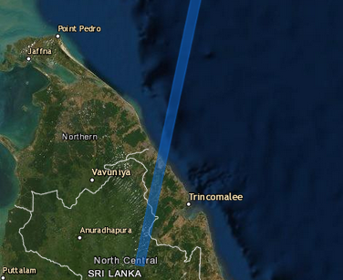
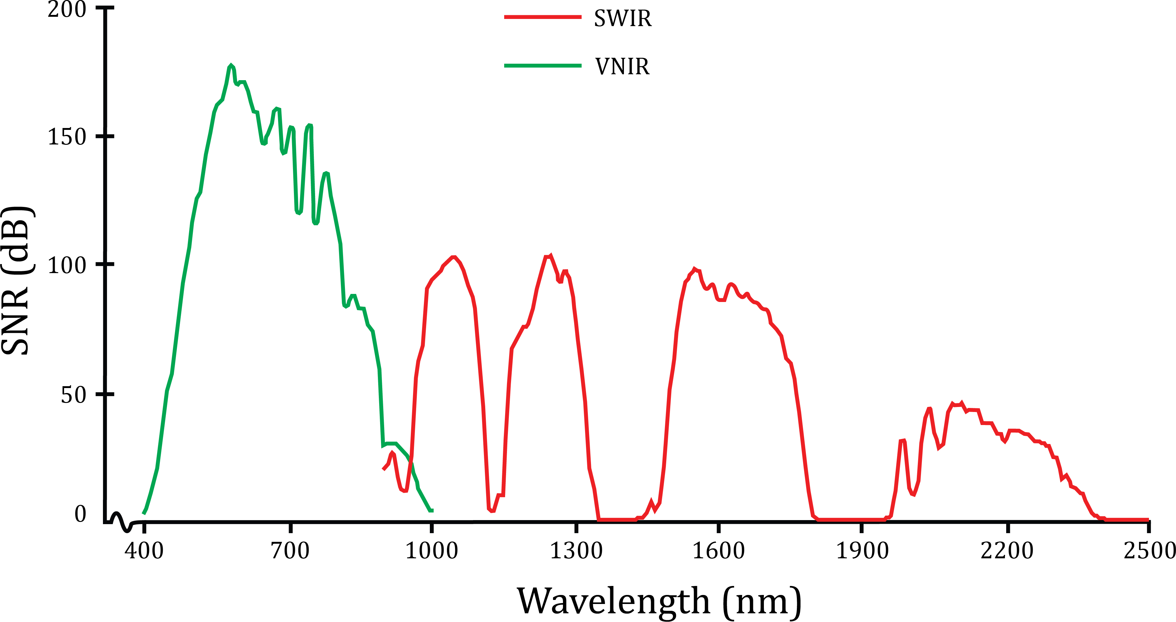
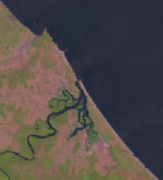
Image Acquisition and Pre-Processing
Region Extraction
Removal of Unreliable Spectral Bands
Radiance to Reflectance Conversion
Cropping the region of interest from the HSI image strip.
Uncalibrated and spectral bands with an SNR less than 50dB were removed from the Hyper-Spectral Image.
$ρ$ - Unit less planetary reflectance
$λ$ - Spectral radiance at sensor’s aperture
$d$ - Earth-Sun distance in astronomical units
${ESUN}_{λ}$- Mean Solar Exo-atmospheric Irradiance
$θ_{s}$ - Solar Zenith Angle in Degrees
Image : (Kokaly et al., 2017)
Notes:
The image data were in the form of radiance values. They were converted to reflectance values using the equation below.
The proposed algorithm uses reflectance values as they
represent the chemical composition of materials included in a single pixel. In addition to this, use of reflectance values eliminates the dependability on the detector for the algorithm. Also, reduction in between-scene variability can be achieved through a normalization for solar irradiance.

Slide 8
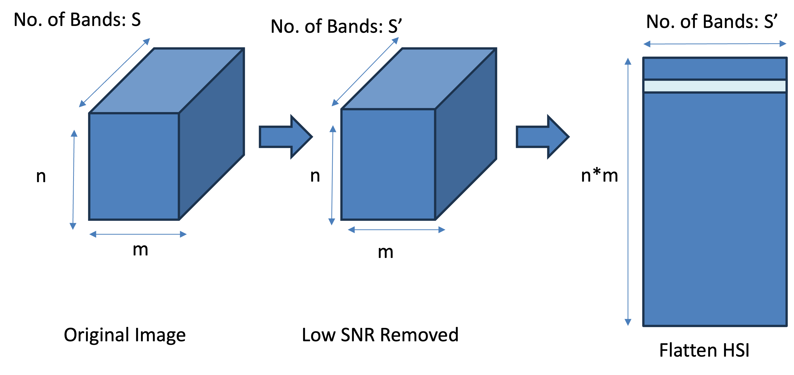
Image Acquisition and Pre-Processing
Pixel Signature
(each pixel is normalized)
Notes:
Response of each spectral band for a given pixel. → Spectral Sig/ Pixel Signature

Slide 9
Detection and Isolation of Macroscopical Components
Depending on the terrain of interest different macroscopical components can be identified (End-Members).
Ex: Soil, Water, Vegetation, Roof, Rock, Road etc.
This stage of the algorithm tries to identify,
The number of dominant end members available
Classify the pixels to the specific endmember classes
Image: Bioucas-Dias, J. et al. (2012). Hyperspectral Unmixing Overview: Geometrical, Statistical, and Sparse Regression-Based Approaches
Notes:
Each of these macroscopical components will have a unique spectral signature which are called the endmembers for a given dataset (HSI)

Slide 10
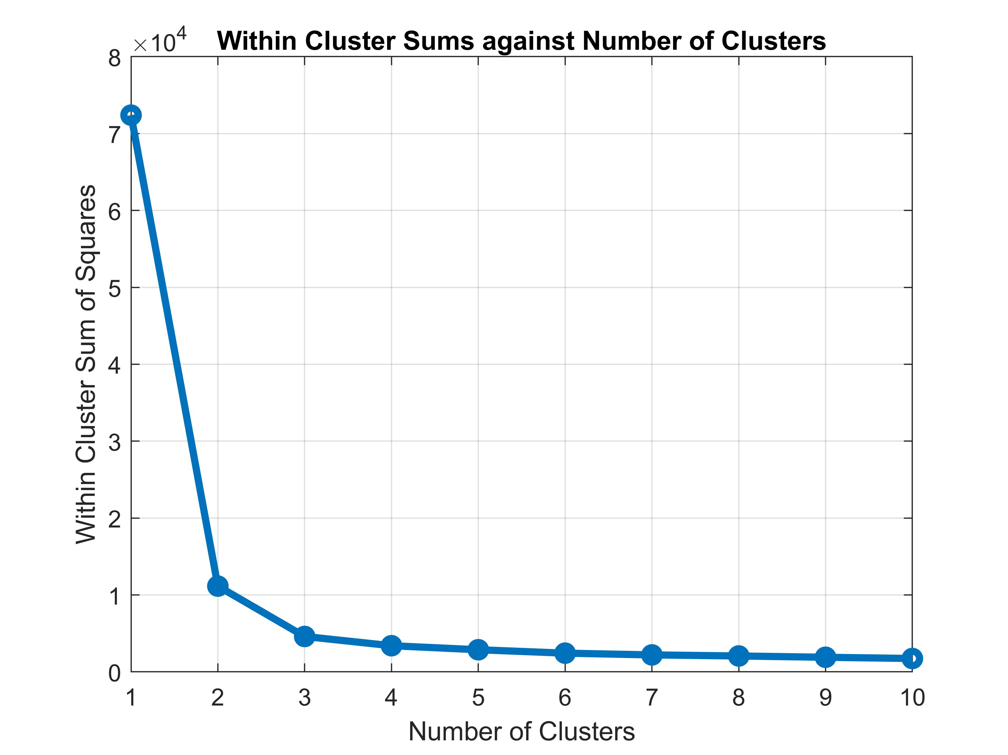
Detection and Isolation of Macroscopical Components
To Identify the number of dominant end members the Elbow Method was used.
Observed the within-cluster sum of squares against the number of clusters to find the optimal number of clusters.
$$2$$
data point in the cluster
centroid of the cluster
​number of data points in the cluster
is the number of clusters
Notes:
Iteratively do K-Means Clustering and observe the within-cluster sum of squares values.
For each data point xi in cluster K calculate the squared Euclidean distance between x and its cluster centroid ci​.
Sum up these distances for all data points in all clusters.

Slide 11
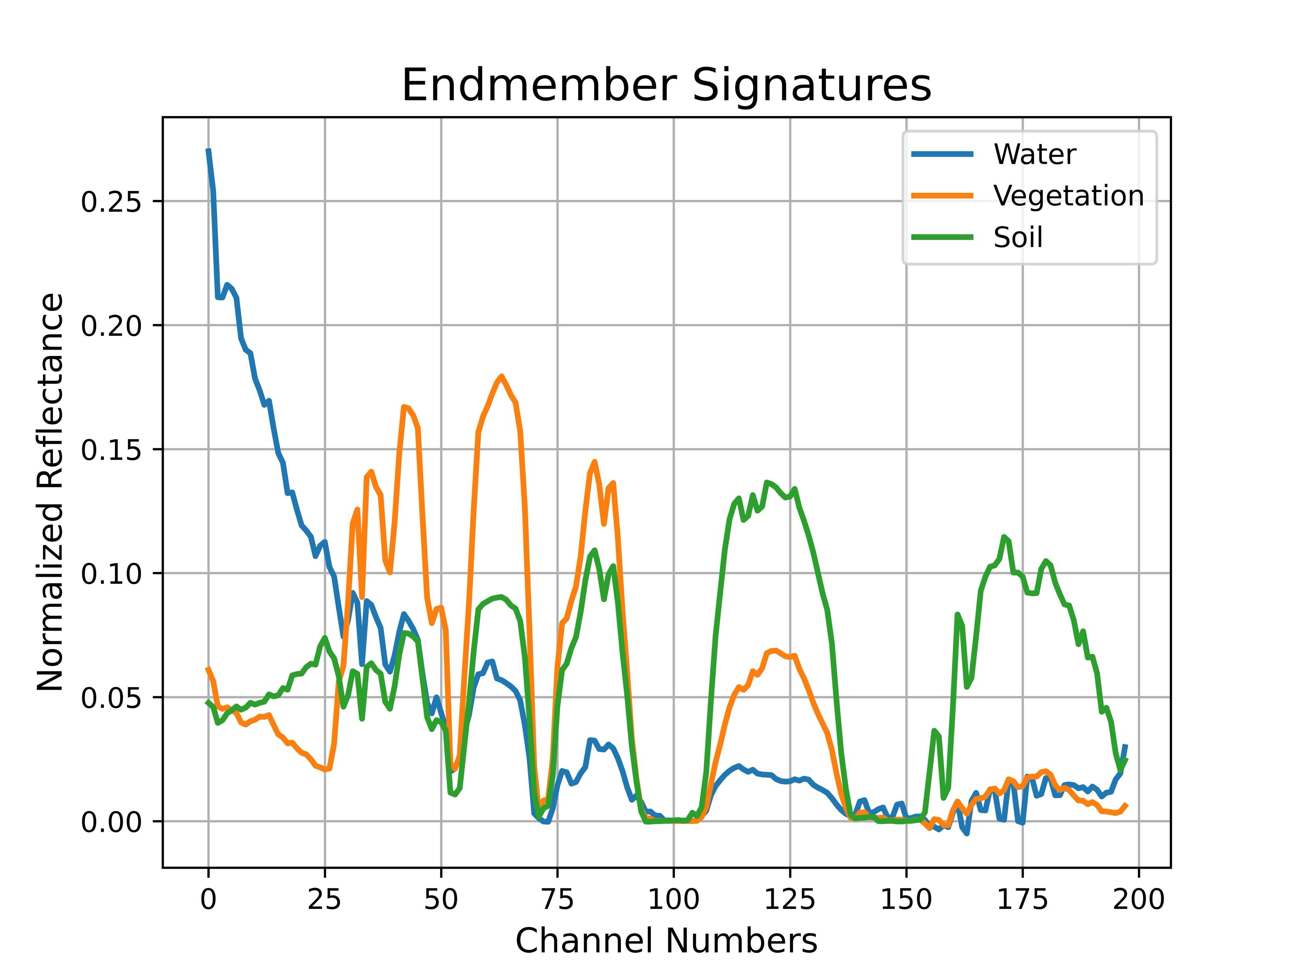
Detection and Isolation of Macroscopical Components
spectral bands
Vertex Component Analysis (VCA) was used to extract candidate endmembers for each macroscopical class.
Then, an affinity measure was computed between the normalized pixel signatures and each candidate end member.
pixels
VCA
data matrix
Similarity between i^{th} reference signature and m^{th} pixel signature
Spectral signature of m^{th} pixel
Spectral signature of i^{th} candidate endmember
- candidate endmembers - Pulmuddai
Notes:
a blind source separation algorithm which is employed for unsupervised endmember extraction from hyperspectral data,
As we have extracted the end members next, we need to label each pixel under the macroscopical components. For that an
affinity measure to see how close the pixel signature is to each candidate end member.
reciprocal of the Euclidean distance between the pixel signature and the candidate end member,
The denominator ensures that all ${ γ}_{m}^{i}$ values for all i’s for a given m sums to one.

Slide 12
Detection and Isolation of Macroscopical Components
Depending on the similarity measure $γ_{m}^{i}$ , the pixels were assigned to each of the macroscopical components represented by the candidate endmembers.
given m,
if $γ_{m}^{i}$ $≥0.5$ ($for i$ = 1,2,3)
Assign pixel $m$ to class $i$
Else
Unassigned
$γ_{m}^{1}$ | $γ_{m}^{2}$ | $γ_{m}^{3}$
Similarity with each candidate endmember
pixel m
Rule Base

Slide 13
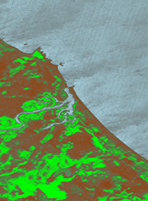
Detection and Isolation of Macroscopical Components
Assuming three end members – soil, water, vegetation
True color HSI
Candidate Endmembers
Identified Map Component

Slide 14
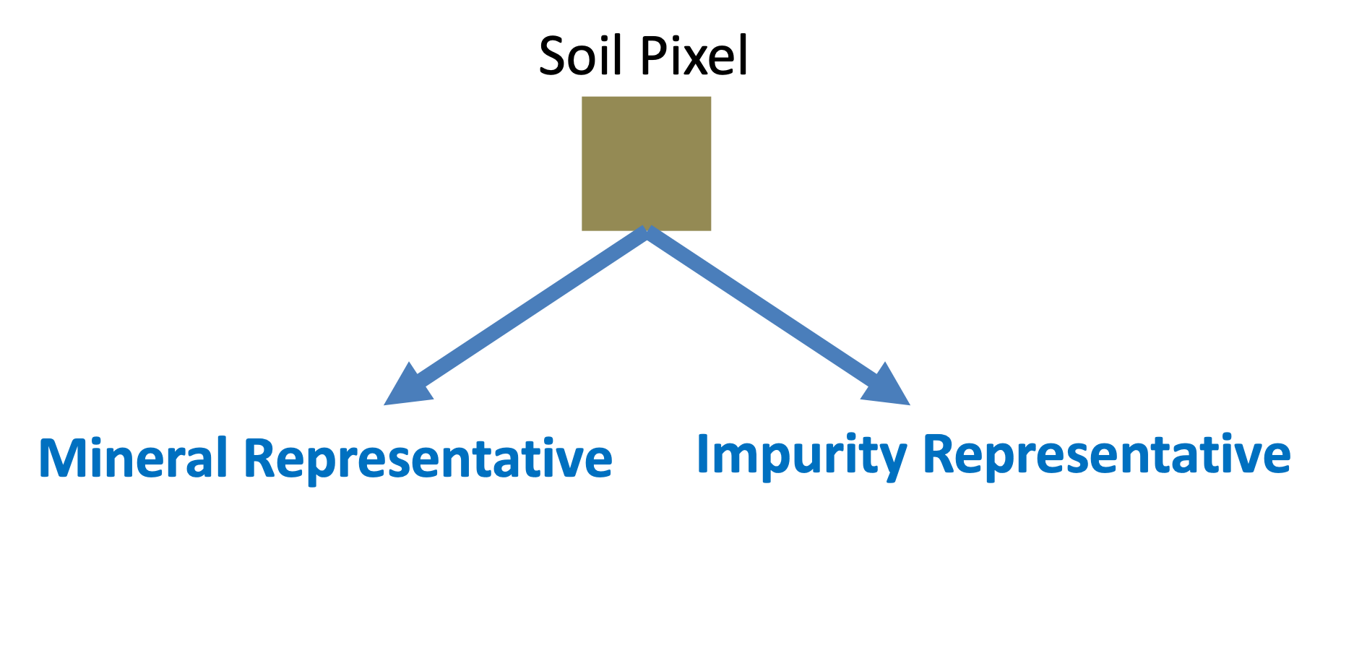
Sub-Class Identification
As the targeted minerals are mostly present in the soil, initially, the soil pixels were isolated from the others.
Next, an assumption was made that the soil pixels could be further separated into two classes.
Pixels with traces of target mineral. (mineral sub-class)
Pixels without minerals. (residual impurity sub-class)
Notes:
The targeted minerals are mostly present in the soil or the sand.

Slide 15
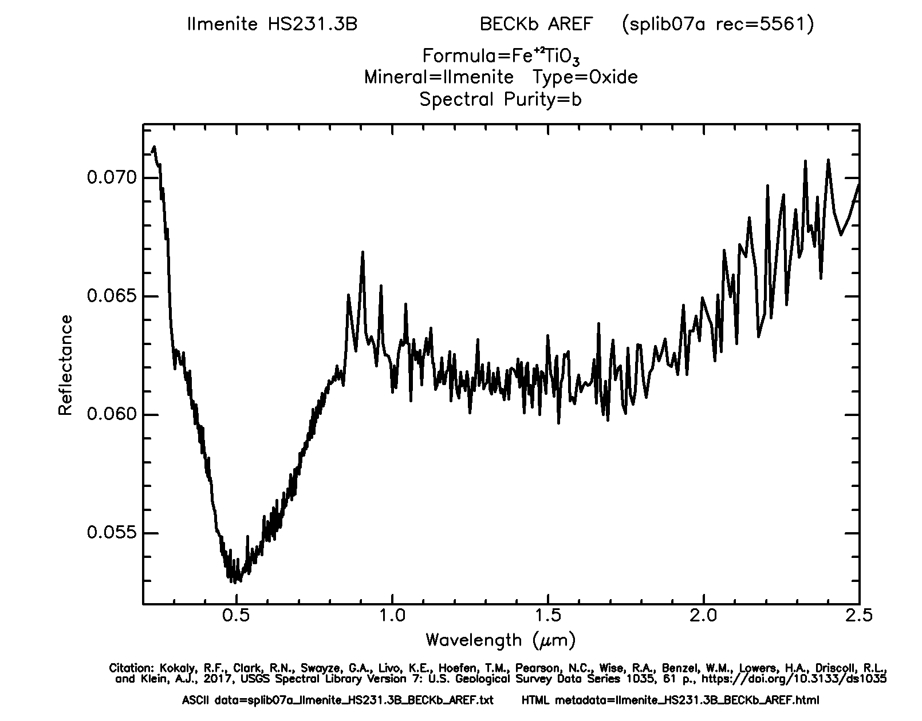
Sub-Class Identification
To identify the two classes, a brief analysis involving, the correlation coefficient between soil pixel signatures and the reference signature for the desired mineral was carried out.
STEP 01: Retrieval of reference mineral signature from USGS spectral library (Kokaly et al., 2017).
Spectral Signature of the Mineral
Image: Kokaly et al., 2017

Slide 16
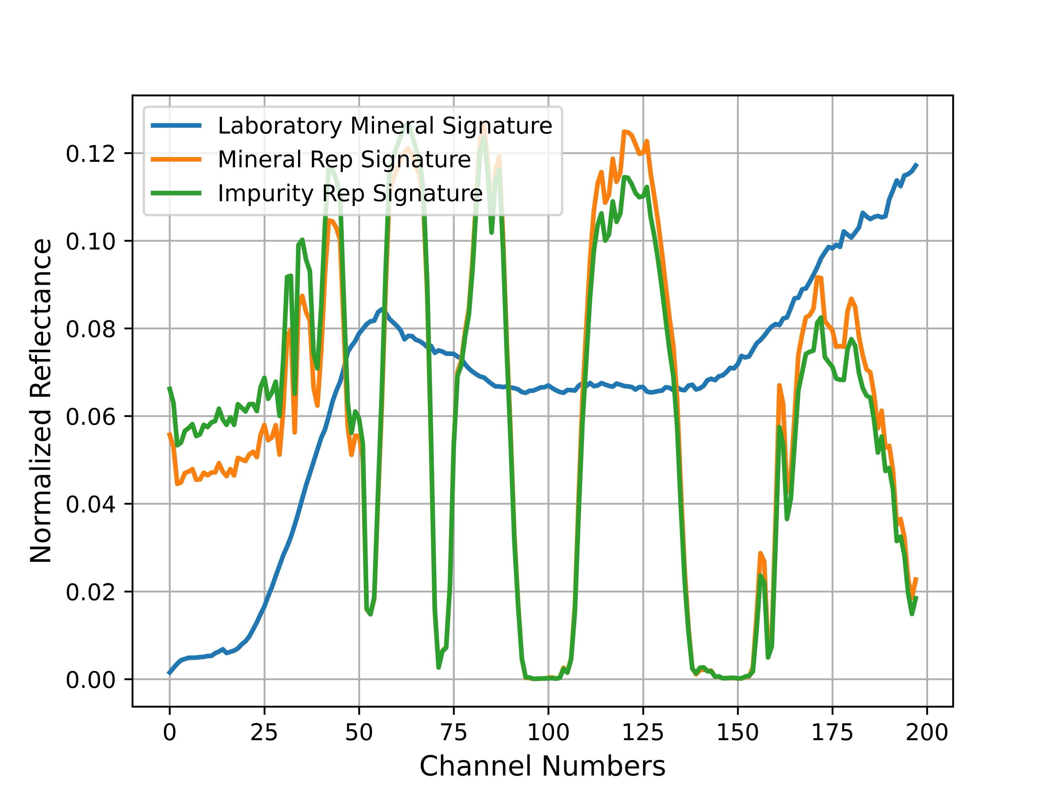
Sub-Class Identification
STEP 02: Extracting two endmembers from the soil pixel manifold and computing the Pearson correlation coefficient with reference mineral signature.
mineral_Rep_Sig → Endmember with Highest Correlation
impurity_Rep_Sig → Endmember with Least Correlation
Let’s denote,
$$corr(mineral,mineral_rep_sig) = C1$$
$$corr(mineral,impurity_rep_sig) = C2$$
bands
VCA
soil pixels
Notes:
We aim to assign the soil/sand pixels to the mineral and impurity_sub classes.
We extracted two endmembers from the soil pixel manifold.
Next, the correlation between these extracted end members and the laboratory reference signature was calculated.

Slide 17
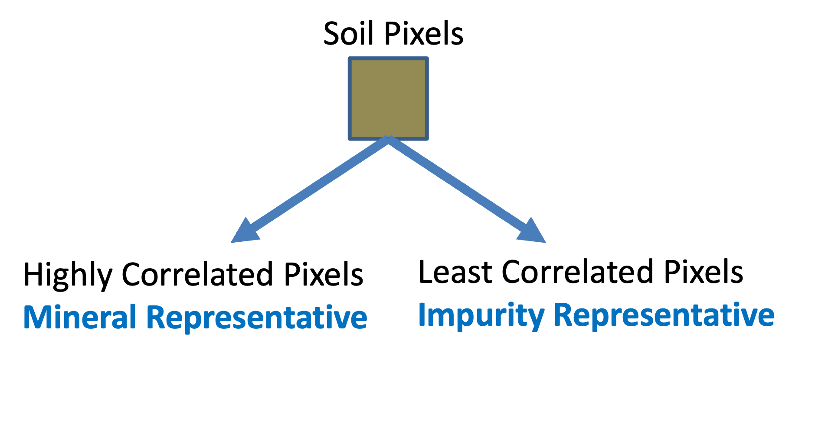
Sub-Class Identification
STEP 03: Pixels belonging to the mineral and impurity sub-classes were identified based on the correlation between soil pixel signatures and reference signatures, and the threshold values computed in above step.
1. for pixel in soil_pixels do
2. if $corr\left(pixel,mineral\right) ≥C1$then
3. ′mineral_representative′
4. else if $corr\left(pixel,mineral\right)≤C2$then 5. ‘impurity_representative′
6. else
7. ′unassigned′
8. end if
9. end for
(l)
(r)
Representative classes
Notes:
Now, to assign the soil pixels into mineral and impurity subclasses the following procedure was followed.
correlation between the laboratory mineral signature and the signature of pixel
This way we can identify the highly correlated pixels to the laboratory signature of the mineral.

Slide 18
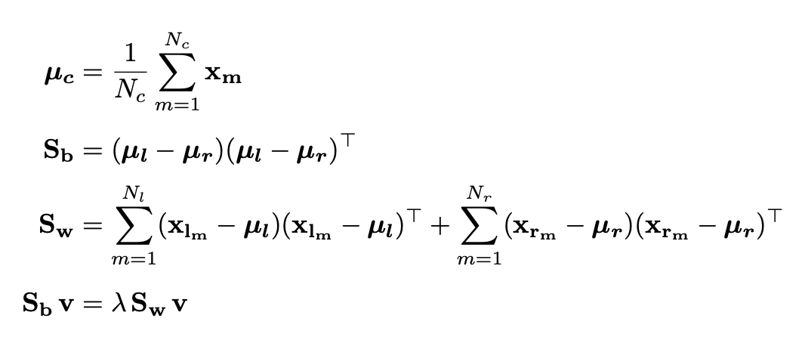
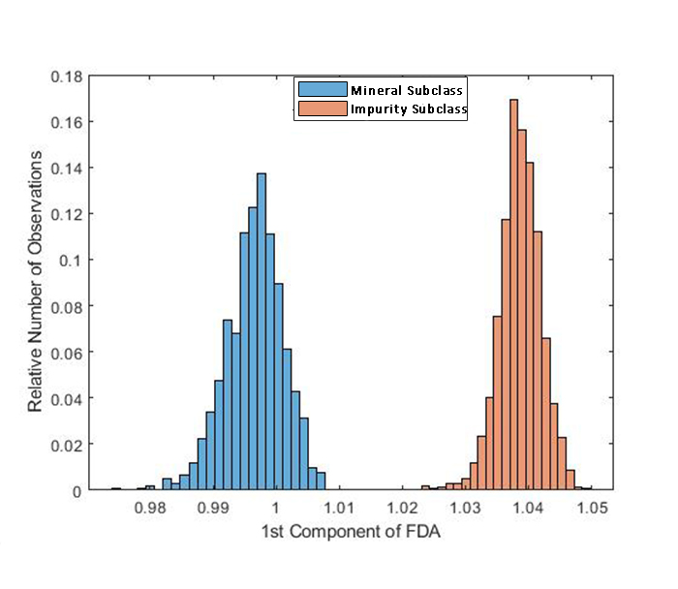
Alignment of Soil Pixels for Purity
To identify the relative availability of minerals the separability of the mineral and impurity representative classes had to be increased. For this Fischer's Discriminant Analysis (FDA) was used.
Through this, the eigen-direction with the highest separation between the two classes was identified.
$Sb$ – Between class scatter matrix
$Sw$ – Within class scatter matrix
$λ$ – Eigen value
$v$ – corresponding eigen vector $μc$ – mean spectral signature of class c
$Nc$ – Number of pixels in class c
$xcm$ – vector representation of soil pixels of class c.
Purity Increases
Notes:
To calculate the measure relative availability for the mineral we aligned the manifold of soil pixels using FDA so the two classes would be at the opposite ends of the eigen direction.
Fisher’s linear discriminant attempts to find the vector/eigen direction that maximizes the separation between classes of the projected data.
The eigen-direction was found through an eigen-decomposition of the matrix Sw_1Sb

Slide 19
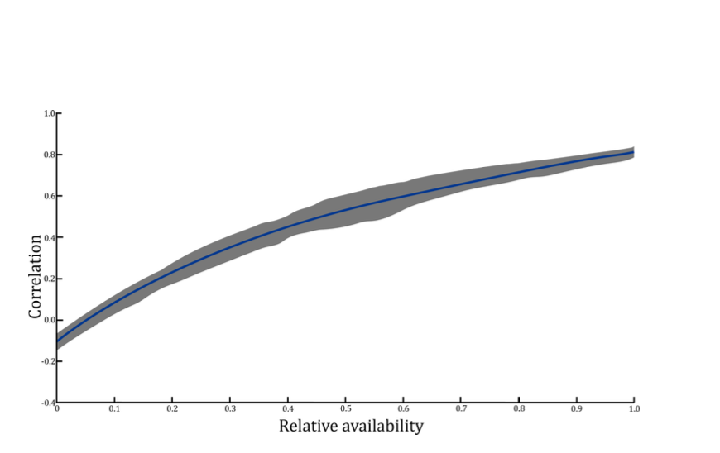
Alignment of Soil Pixels for Purity
Purity Increases
Variation of the Correlation with RA
Notes:
Now since the least correlated and the most correlated sub classes are on the opposite ends along the eigen direction, along this direction the correlation between the pixel signatures to the mineral signature changes monotonically.
The use of FDA with two classes produces an eigen-direction along which the correlation is monotonically changing since the least-correlated and most-correlated sub-classes are on the opposite extremes along this eigen-direction.

Slide 20
Alignment of Soil Pixels for Purity
$$u$$
Following spectral signatures were projected onto this eigenvector of highest separation.
Mean spectral signature of mineral sub-class :
Mean spectral signature of impurity sub-class :
$$v_{1}$$
Signature of the m^{th} pixel :
$$u$$
Then, the distance between a pixel $x_{m}$ , and the mean representative signatures of each sub-class and were calculated along $v_{1}$.
$$v_{1}$$
$x_{m}$
Notes:
Let’s say that the eigen direction which maximizes the separation between the two classes is v1.
To derive the relative availability measure we projected the following spectral signatures on to this direction.
Now every thing is on a line. Next we calculated the distance between the projected pixels and the two projected mean spectral signatures of each sub-class.
Once the eigen direction${ (v}_{1})$ which promotes the highest separation between the two representative classes was identified, the following spectral signatures were projected onto this eigenvector.

Slide 21
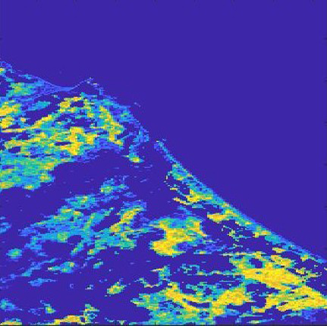
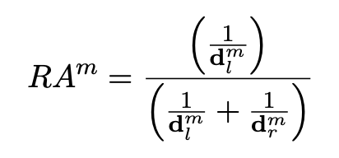
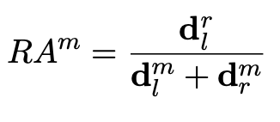
Relative Availability of the Mineral
Finally, the Relative Availability (RA) of the mineral in a pixel was defined as,
Relative Availability (A) of ilmenite in the coastal region
of Pulmuddai Sri-Lanka
Notes:
Finally, the relative-availability was calculated using this equation.
Relative availability of the mth pixel is ,

Slide 22
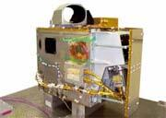
Case Studies in Sri Lanka’s Mineral Exploration
Imager: Hyperion Sensor - NASA Earth Observing 1
242 spectral bands
spatial resolution: 30 m
Standard scene,
Width: 7.7 km
Length: 42 km
Applications in: environmental monitoring, geological exploration, agricultural assessment
Datasets:
198
242
198
$$pixels × pixels$$
Original Image
Low SNR Removed
Flatten Data Matrix
Image: https://www.usgs.gov/centers/eros/eo-1-sensors
Notes:
from 0.357 to 2.576 µm with a 10 nm bandwidth.

Slide 23
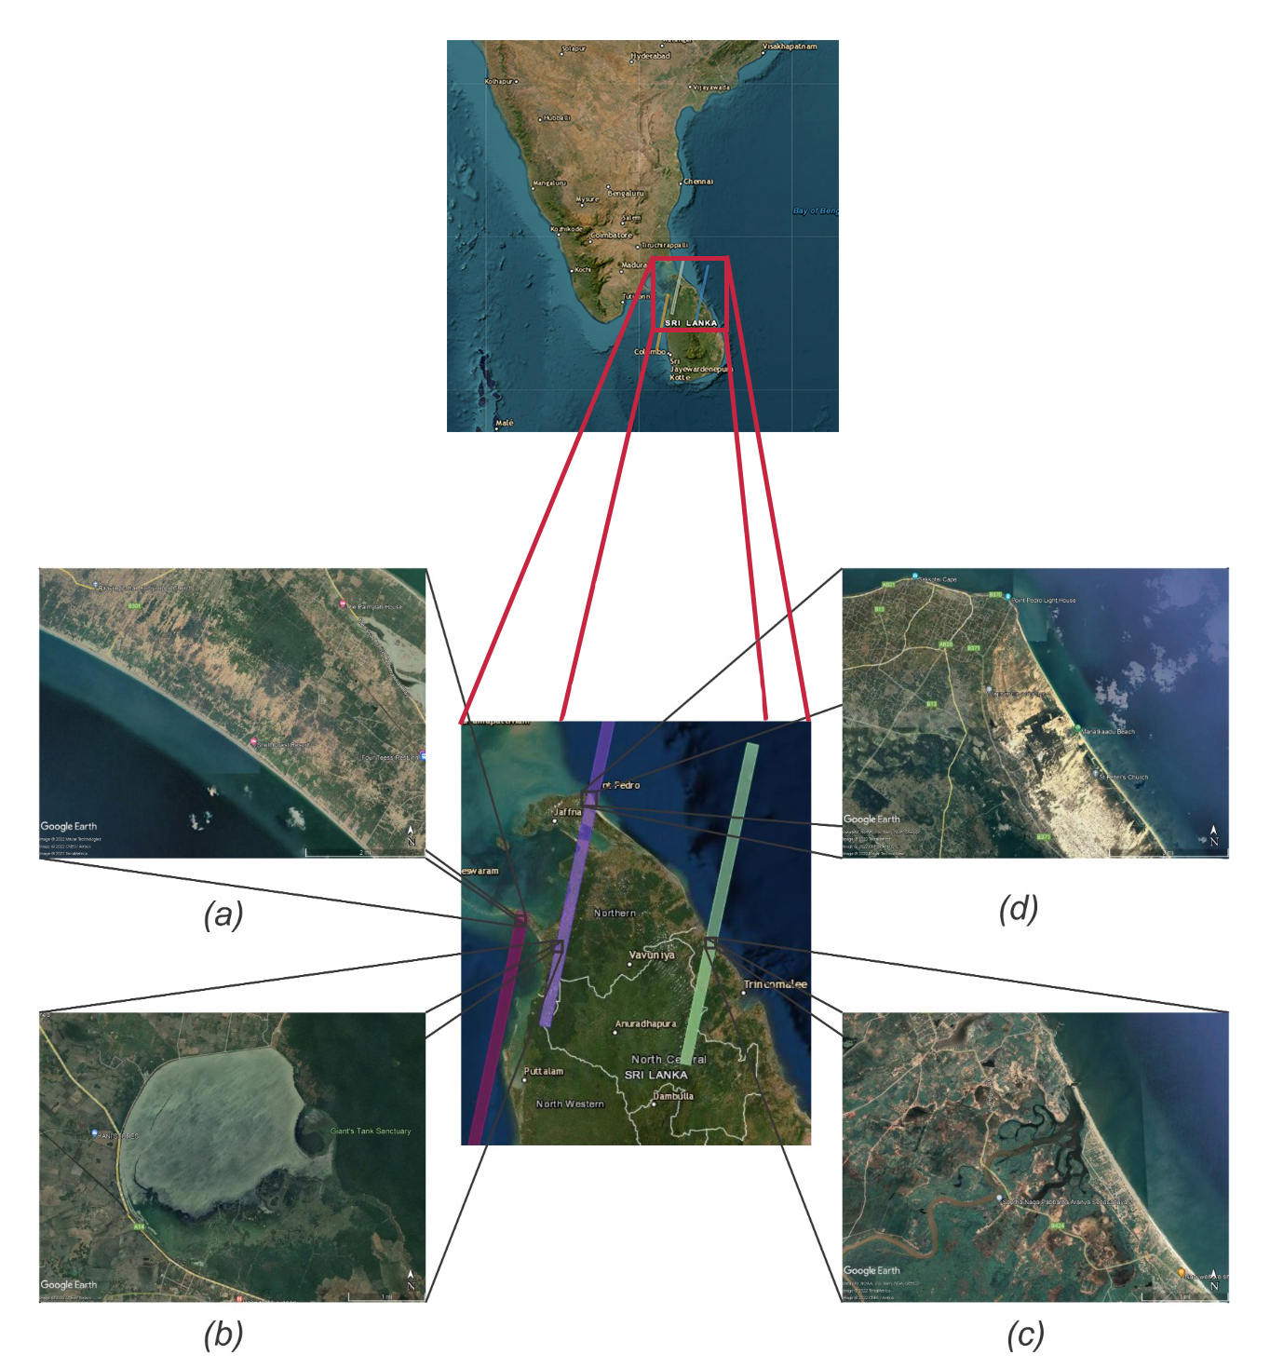
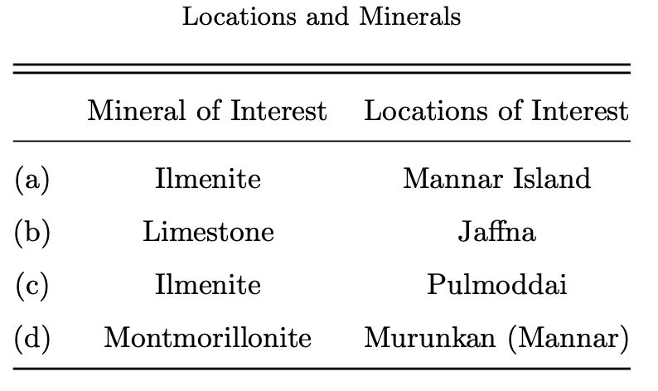
Case Studies in Sri Lanka’s Mineral Exploration
Sites and Minerals
The study focuses on three minerals.
The regions of interest were selected based on previous
studies and knowledge on mineral availability.
Each location was distinct in terms of:
Mineral
Terrain
Relative availability of the mineral
Image: Google Earth

Slide 24
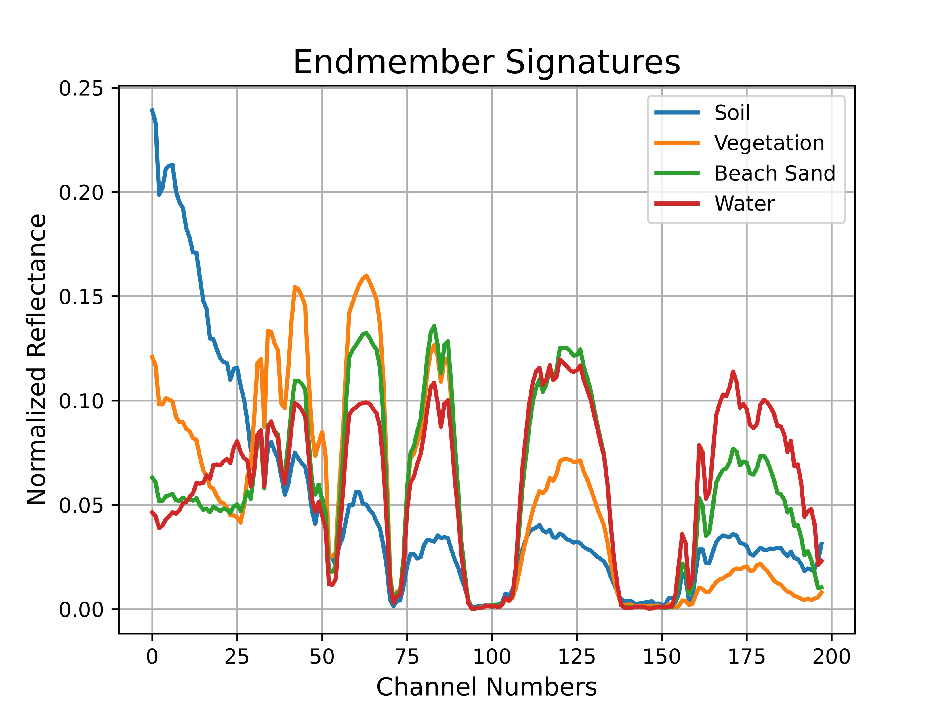
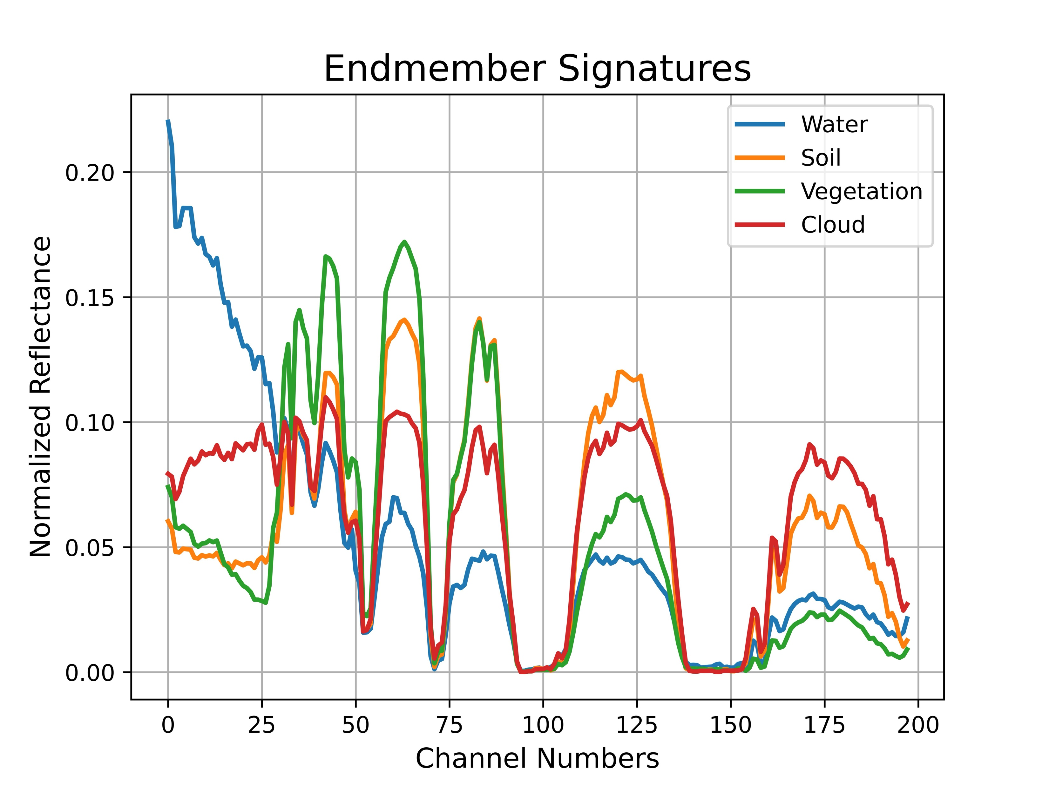
Results
Identification of Macroscopical Components
Jaffna
Murunkan- Mannar

Slide 25
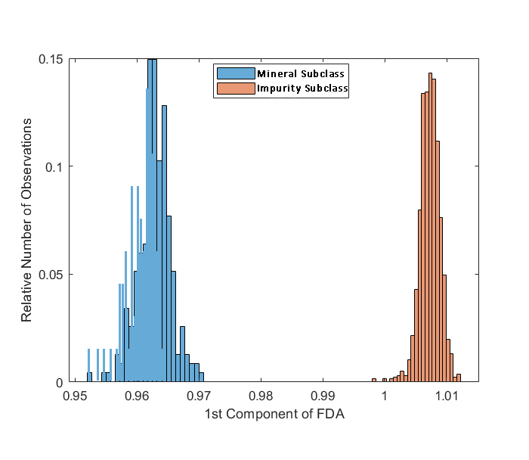
Results
Soil Pixel Alignment for Purity
Separation between mineral and impurity sub classes
Jaffna – Limestone
Murunkan - Montmorillonite

Slide 26
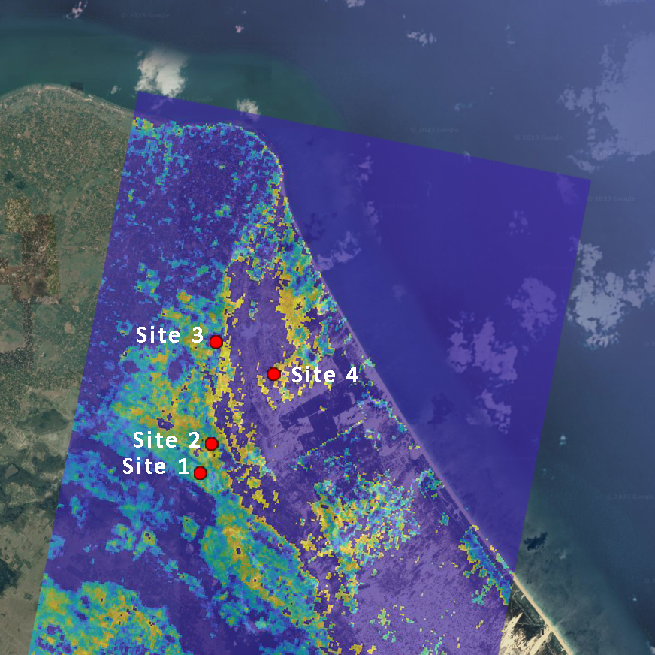
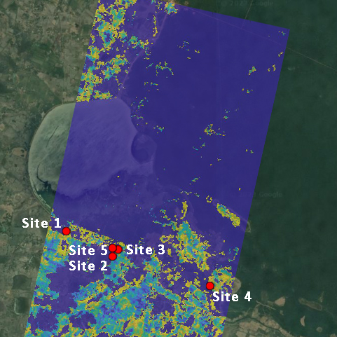
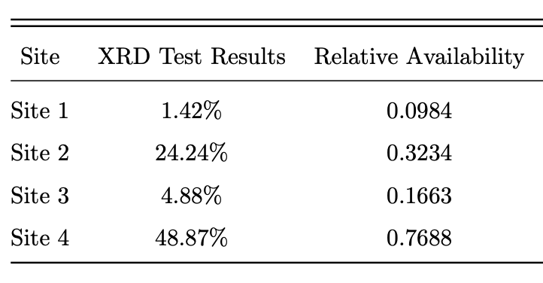
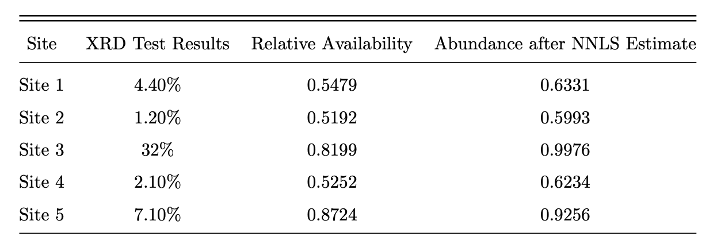
Results
Relative Availability in Comparison with the X-Ray Diffraction Test Results
Jaffna - Limestone
Murunkan-Montmorillonite

Slide 27
Thank You !

