Slide 1
Object Detection with Crowdsourced Annotations: Synthetic Datasets & Annotations Aggregation Framework
Zhi Qin Tan, Olga Isupova, Gustavo Carneiro, Xiatian Zhu, Yunpeng Li
University of Surrey, UK

Slide 2
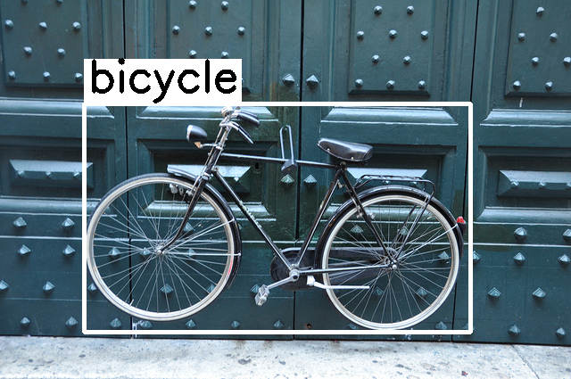
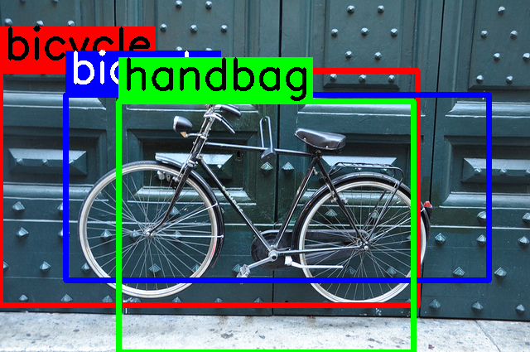
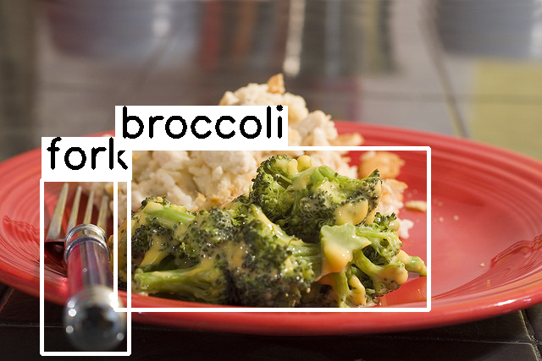
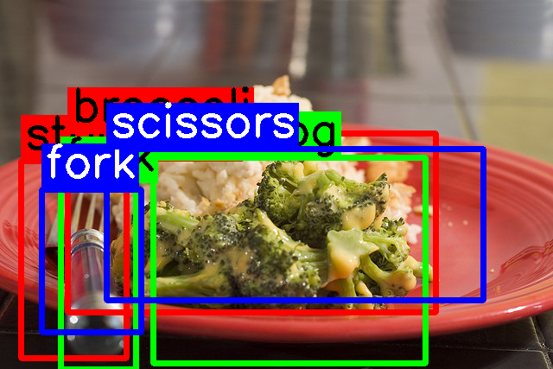
Object Detection with Crowdsourced Annotations
Usual
Crowdsourced
Notes:
Motivation: Difficult and expensive to obtain accurate annotations, due to high interobserver variability. Crowdsourcing as a cheap and promising method to obtain annotations.
Problem: Increased noise due to different level of expertise, dedication of annotators.
Goal: To train a robust object detection model using only noisy crowdsourced annotations.

Slide 3
Object Detection with Crowdsourced Annotations
Given training set , where
and
, , .
Goal: Learn an object detector with noisy crowdsourced annotations to output object predictions, where and .

Slide 4
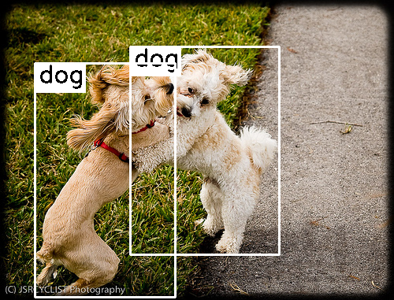
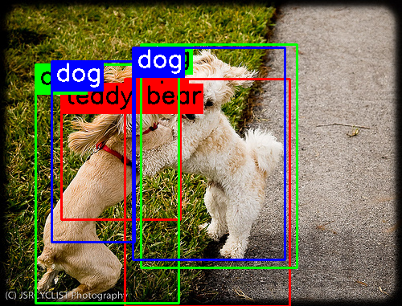
Objectives
Synthesise
Notes:
Introduce a novel method for synthesising crowdsourced object annotation that features instance-dependent noise.
Propose a model-agnostic Bayesian Detector Combination (BDC) framework that infers consensus bounding boxes and soft class labels from noisy, crowdsourced annotations. Without requiring the ground truth or any additional input
Evaluate and analyse BDC by comparing it against previous aggregation methods on both synthetic and real-world crowdsourced datasets.

Slide 5
Objectives
Predict
Object Detector
Synthesise
Aggregate & Train
Notes:
Introduce a novel method for synthesising crowdsourced object annotation that features instance-dependent noise.
Propose a model-agnostic Bayesian Detector Combination (BDC) framework that infers consensus bounding boxes and soft class labels from noisy, crowdsourced annotations. Without requiring the ground truth or any additional input
Evaluate and analyse BDC by comparing it against previous aggregation methods on both synthetic and real-world crowdsourced datasets.

Slide 6
Previous Works
Crowd R-CNN^{[1]}
Model-specific and only works with Faster R-CNN.
WBF-EARL^{[2]}
Requires weights / proficiency level of each annotator.
Assume label-dependent noise which is less realistic.
[1] Y. Hu and M. Song, “Crowd R-CNN: An object detection model utilizing crowdsourced labels,” in Int. Conf. Vis. Image Sig. Process., Bangkok, Thailand, 2020, pp. 1–7.
[2] K. Le et al., “Learning from multiple expert annotators for enhancing anomaly detection in medical image analysis,” IEEE Access, vol. 11, pp. 14 105–14 114, 2023.
Notes:
2. which is difficult to obtain in practice
They also synthesised their own datasets using different setups and assume …

Slide 7
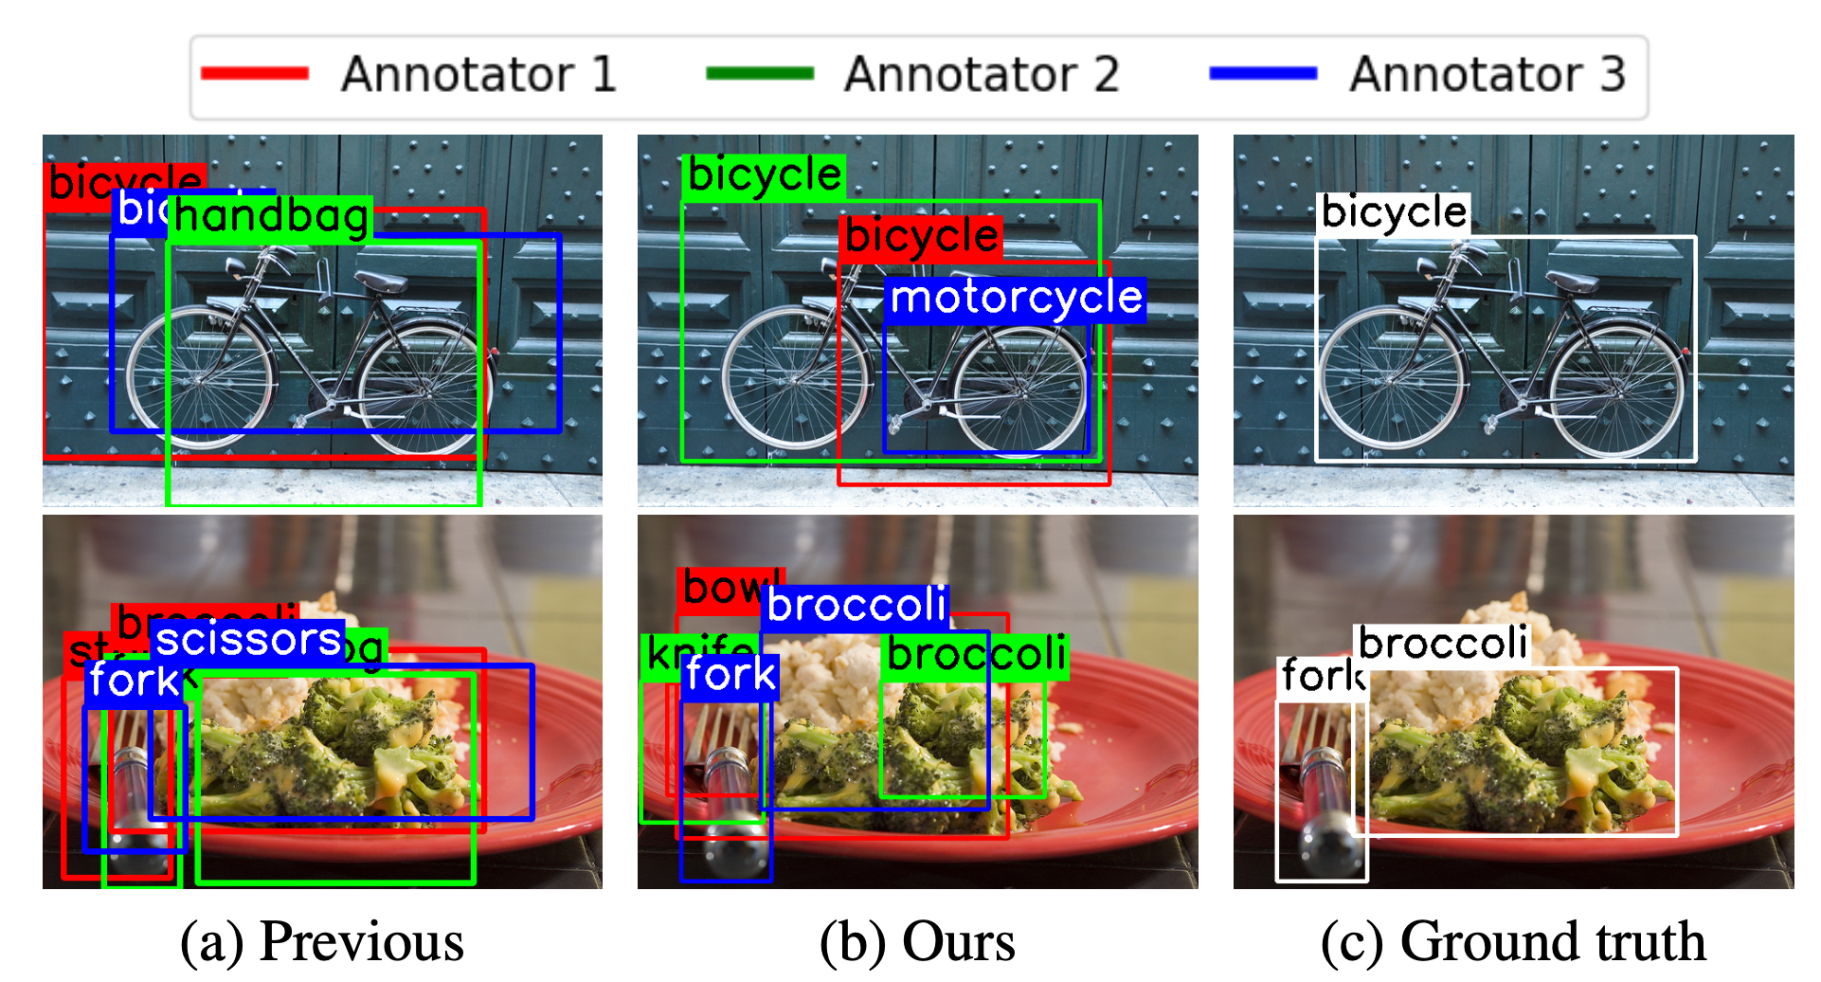
Synthesising Crowdsourced Annotations
Notes:
To facilitate understanding, here is a preview of synthesised annotation. There are two key message here:
Motorcycle is more sensible than handbag
Our proposed method is able to generate bbox around individual broccoli compared to previous method that generate bbox uniformly around the gt box
This show that our method generate more realistic synthetic annotation

Slide 8
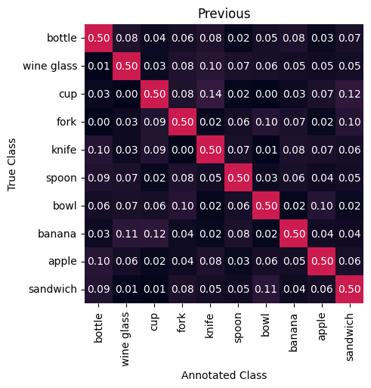
Synthesising Crowdsourced Annotations - Class Label
Represent the annotated class labels as multinomial distributions.
Synthesise annotator label by randomly sampling from the distribution.
Previous methods simply filled the diagonal of the confusion matrix.
Notes:
ignored the visual relationship between closely related classes and assumed that all classes are equal (i.e. non-diagonal elements are sampled from the same distribution)

Slide 9
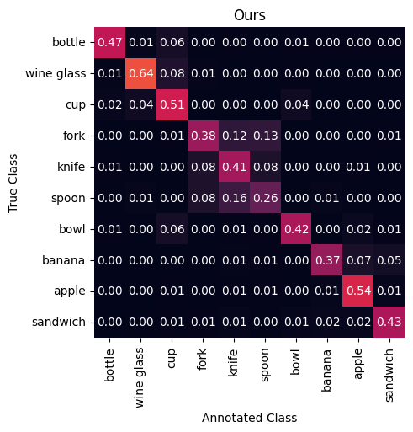
Synthesising Crowdsourced Annotations - Class Label
Use a trained classification model to obtain a confusion matrix, C, of the ground truth and predicted classes.
Generate annotator’s confusion matrix by drawing from Dirichlets(C).
More realistic and have higher confusion between visually related classes.

Slide 10
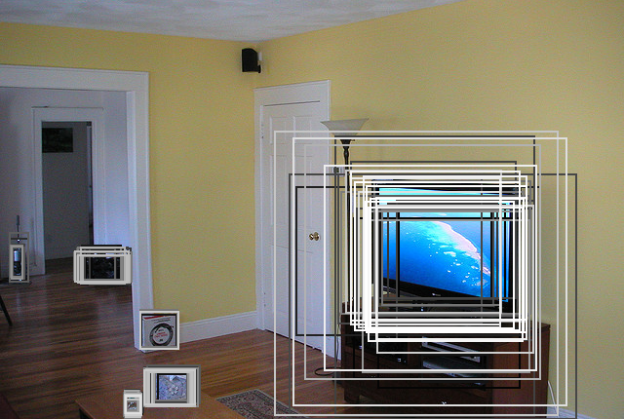
Synthesising Crowdsourced Annotations - Bounding Box
Previous
Ours
Randomly generate bounding box subjecting to an intersection over union (IoU) of > p with the ground truth box.
We propose to utilise a trained Region Proposal Network (RPN) to generate proposal box.
Randomly select a proposal using categorical probability of:- objectness score ⨉ IoU
Notes:
The synthesisation process depends only on the gt box and thus can only simulate label-dependent noise
Our proposed method depends on both the gt box and the input image, hence is able to simulate a more realistic instance-dependent noise

Slide 11
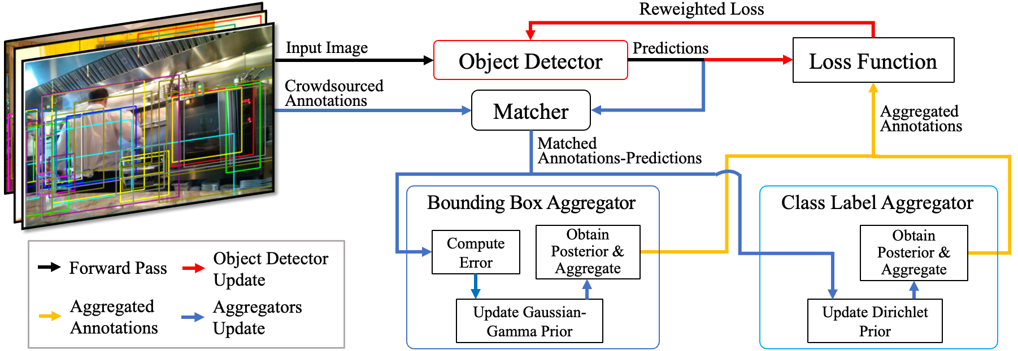
Bayesian Detector Combination
Notes:
since the OD operates as a black-box model in the proposed framework, any algorithm can be used here as long as it outputs the predicted bounding box and class logit/probability of each class.

Slide 12
Annotations to Predictions Matcher
A many-to-one (i.e. many annotations - 1 prediction) assignment problem:
For each annotation, we assign it one prediction with the minimal cost:
Compute 𝜸_{n} as the ratio of the number of matched annotations to the number of total annotators.
Similar to set loss of DETR^{[3]}.
[3] N. Carion et al., “End-to-end object detection with transformers,” in Proc. Eur. Conf. Comput. Vis. (ECCV), 2020, pp. 213–229.
Notes:
2. But the set loss is minimising a global one-to-one matching cost

Slide 13
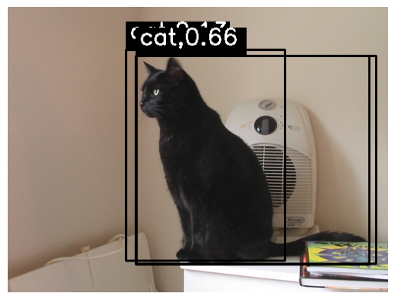
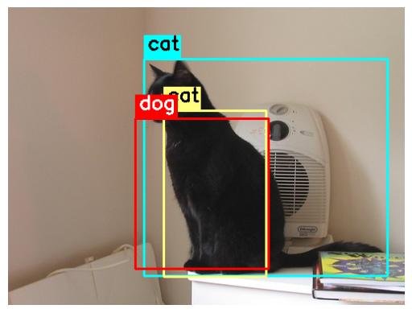
Annotations to Predictions Matcher
cat, 0.66
dog, 0.08
cat
dog
cat
Notes:
Here is a visualisation of the matching process, we have the object predictions at the top and at the bottom is the crowdsourced annotations.

Slide 14
Class Label Aggregator
Model each annotator’s class label accuracy as a multinomial distribution with a Dirichlet prior (extending BCC’s concept^{[4]}).
Use the predicted class probability and the matched annotated class labels to update the prior.
Obtain the expected mean of the Dirichlet to compute the aggregated class label probability.
[4] H. Kim and Z. Ghahramani, “Bayesian classifier combination,” in Proc. Int. Conf. Artif. Intell. Statist. (AISTAT), vol. 22, La Palma, Canary Islands, 2012, pp. 619–627.

Slide 15
Bounding Box Aggregator
Model each annotator’s box translation and scaling error with a Gaussian distribution that has a Gaussian-Gamma prior^{[5]}.
Compute each annotation box’s error against the matched prediction box.
Update the priors with the computed error terms.
[5] K. Murphy, “Conjugate bayesian analysis of the gaussian distribution,” Nov. 2007

Slide 16
Bounding Box Aggregator
Obtain each annotator’s posterior mean and precision to:
Correct each annotated box with the expected posterior mean.
Aggregate all boxes matched to the same prediction with weighted average, using precision of each annotator as weight.
Notes:
The idea is that if the annotator is less consistent (i.e. low precision), we will assign lower weight when averaging

Slide 17
BDC Training Pipeline
Initialise all parameters accordingly (the aggregators and object detector).
Use the current values of the aggregators’ parameters to aggregate the bounding box and class label annotations.
Train the object detector with the aggregated annotations and reweighted loss.
Obtain predictions using the object detector to update the priors of the aggregators.
Repeat 2-4 until convergence.

Slide 18
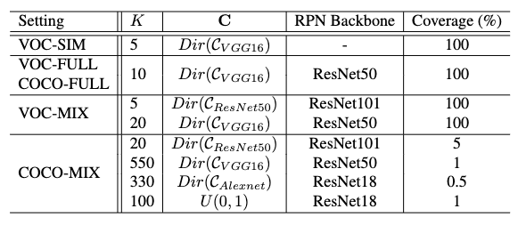
Experiment Settings
Synthesise crowdsourced dataset using Pascal VOC^{[6]} and MS COCO^{[7]}.
Use different classification models and RPN models to simulate annotators of varying skill levels.
[6] M. Everingham et al., “The PASCAL Visual Object Classes Challenge 2007 (VOC2007),” Int. J. Comput. Vis., vol. 88, pp. 303–338, Jun. 2010.
[7] T.-Y. Lin et al., “Microsoft COCO: Common objects in context,” in Eur. Conf. Comput. Vis., Zurich, Switzerland, 2014, pp. 740–755.
Notes:
The table here summarised the 5 synthetic dataset. We have the simplest dataset with only 5 annotators and we only change the class label.
FULL dataset with 10 annotators of average annotating accuracy. MIX dataset with annotators of different skill levels.

Slide 19
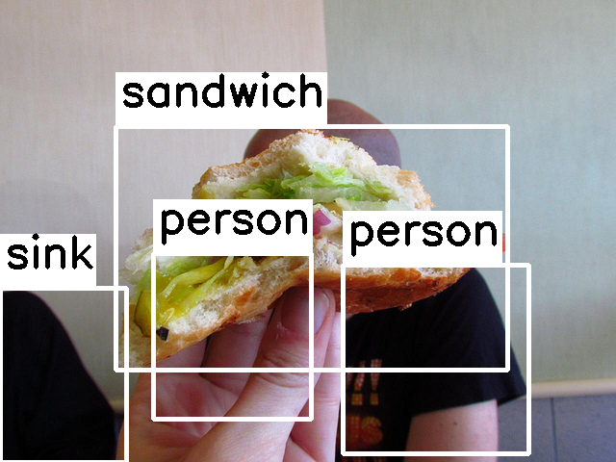
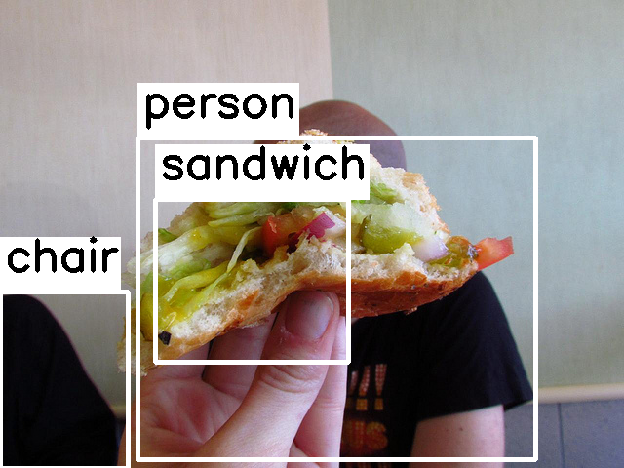
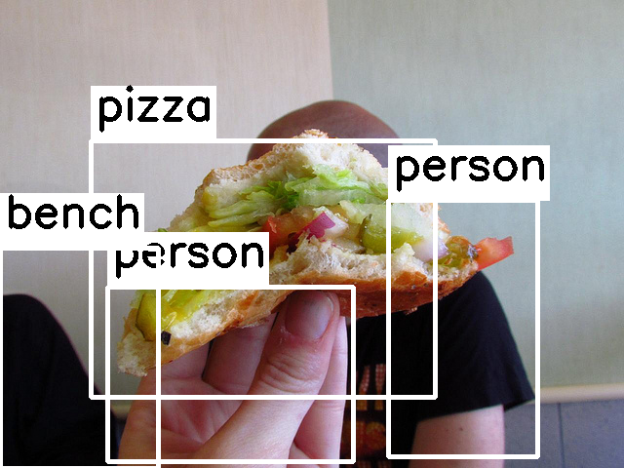
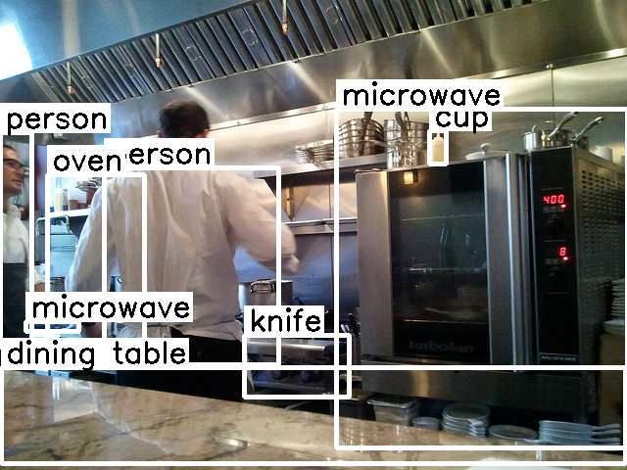
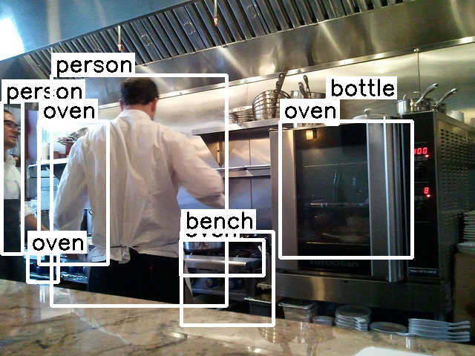
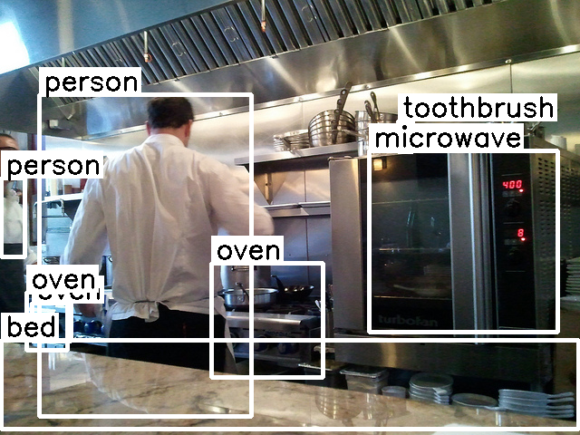
Example of Synthesised Annotations

Slide 20
Experiment Settings
Real-world crowdsourced dataset: VinDr-CXR^{[8]}
Thoracic abnormalities detection dataset.
14 classes, 15,000 training and 3,000 testing chest radiograph images.
Annotated by 17 experienced radiologists.
Evaluation metrics
Average precision (AP) under various IoU threshold, i.e. AP^{.5}, AP^{.75}, AP^{.5:.95}.
For object predictions on the test dataset and aggregated annotations on the train dataset.
[8] H. Q. Nguyen et al., “VinDr-CXR: An open dataset of chest x-rays with radiologist’s annotations,” Sci. Data, vol. 9, no. 1, p. 429, Jul. 2022.

Slide 21
Experiment Settings
Object detectors considered:
YOLOv7 (CVPR 2024)
One stage, CNN
Faster R-CNN (NeurIPS, 2015)
Two stage, CNN
EVA (CVPR 2023)
Two stage, Transformer
Baselines considered:
NA
No aggregation, train with all annotations.
MV
Cluster all annotations, then perform majority voting of the class labels and bounding boxes.
Crowd R-CNN^{[1]}
WBF-EARL^{[2]}

Slide 22
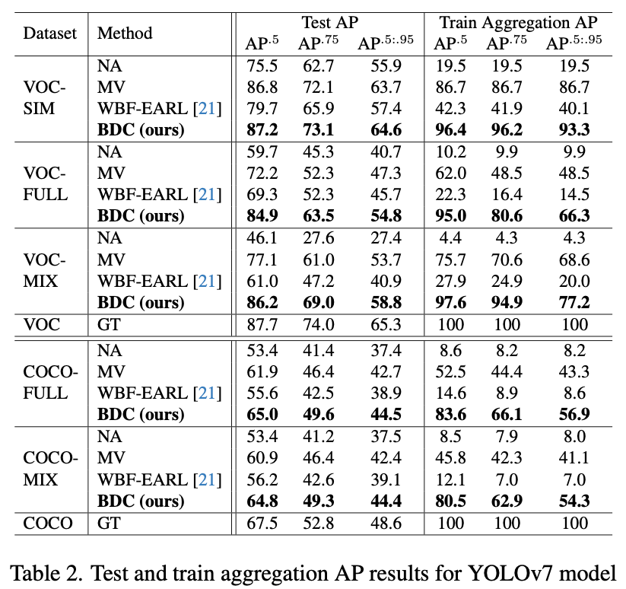
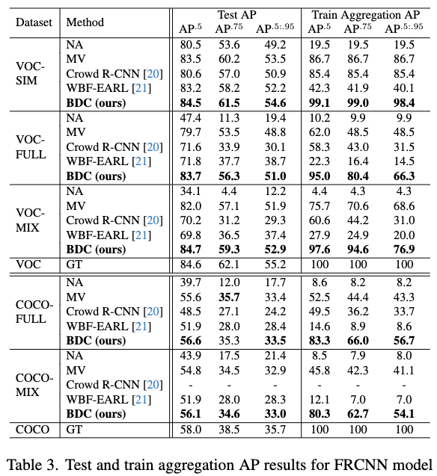
Experiment Results
YOLOv7
Faster R-CNN
Notes:
The tables here shows the performance metric

Slide 23
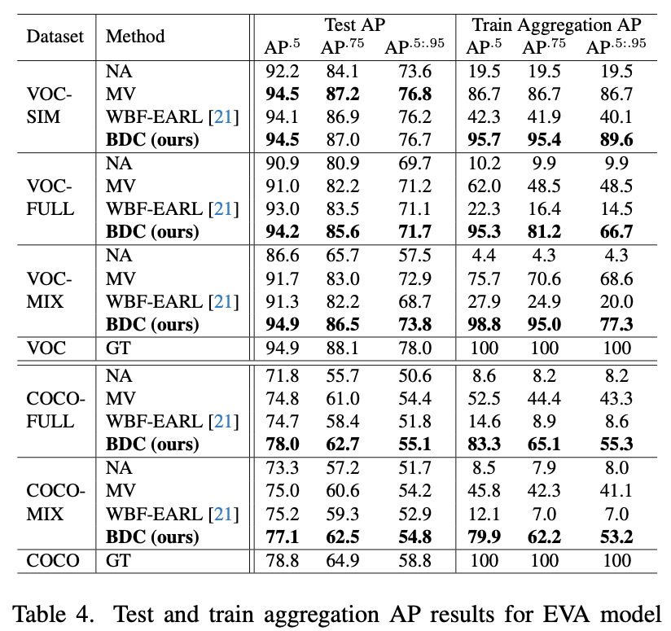
Experiment Results
EVA

Slide 24
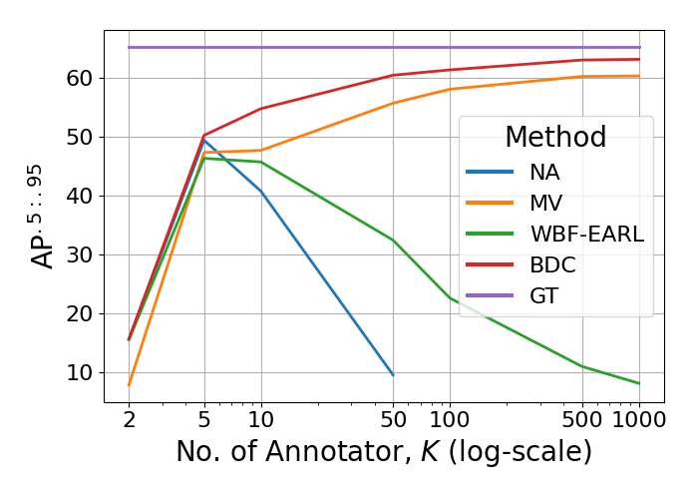
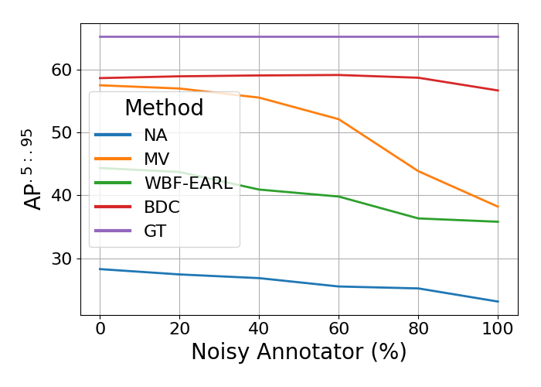
Robustness and Scalability
Our proposed BDC is robust and can scale against increasing number of annotators and percentage of noisy annotators.

Slide 25
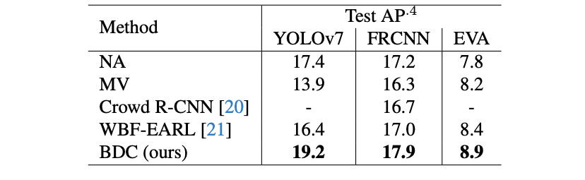
Real-world Crowdsourced Dataset
AP^{.4} results obtained from the private score of VinBigData Kaggle competition^{[9]}.
[9] DungNB et al., “VinBigData chest x-ray abnormalities detection,” 2020. [Online]. Available: https://kaggle.com/competitions/vinbigdata-chest-xray-abnormalities-detection

Slide 26
Summary
Introduced crowdsourced annotation synthesisation method with instance-dependent noise that is more realistic.
Proposed a generic annotation aggregation and object detection framework, Bayesian Detector Combination (BDC).
Demonstrated the superior performance, robustness and scalability of BDC.
Notes:
Introduced crowdsourced annotation synthesisation method with instance-dependent noise that is more realistic compared to prior work.
Proposed a generic annotation aggregation and object detection framework, Bayesian Detector Combination (BDC). Infers the consensus soft class labels and corresponding bounding boxes without the need of GT.
Demonstrate the superior performance, robustness and scalability of BDC on object detection datasets with both synthetic and real-world crowdsourced annotations. Showed its ability to scale against varying number of annotators and robust against annotators with low annotation reliability

Slide 27
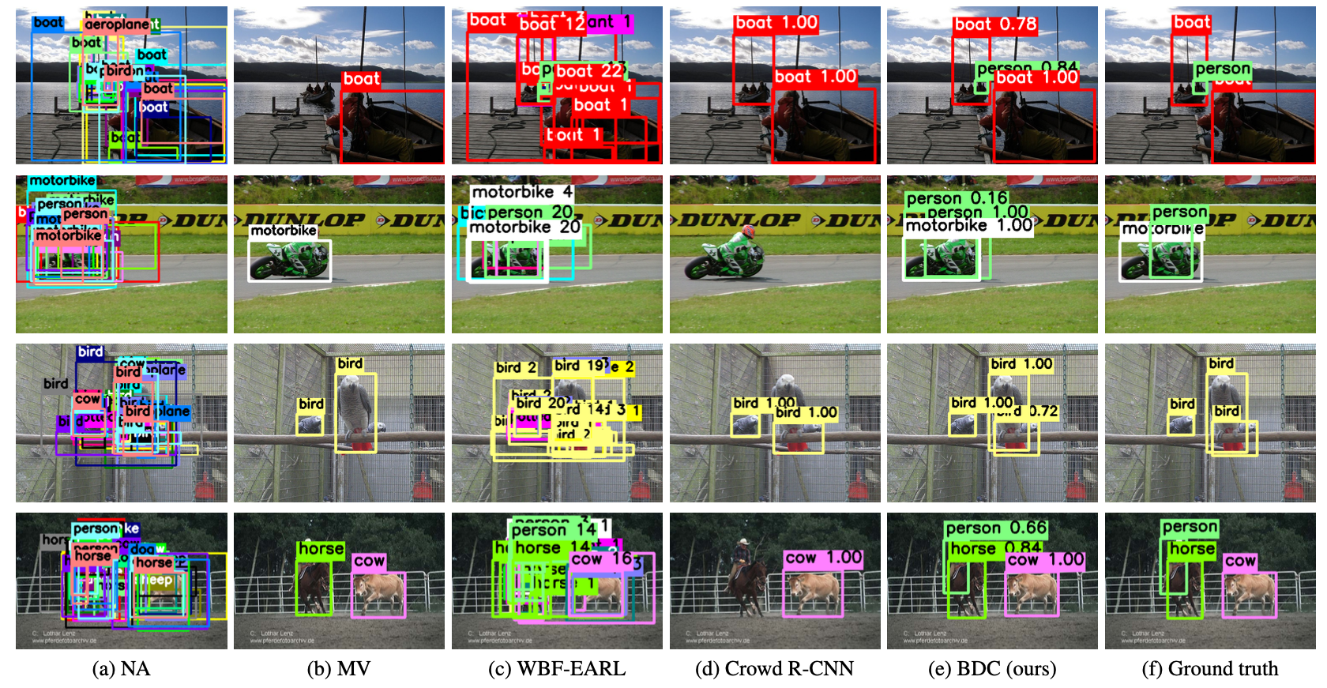
Qualitative Results

