Slide 1
Visualizing Relationships within High Dimensional Datasets: A Topological Data Analysis Approach
Jon Rasnitsyn

Slide 2
Data Visualization
Data visualization is important because it helps identify relationships, relay insights, and motivate further analyses
The effectiveness of a particular visualization is often tied to Gestalt Principles⁸
Gestalt school of psychology: studies how we group and separate elements based on how we perceive them

Slide 3
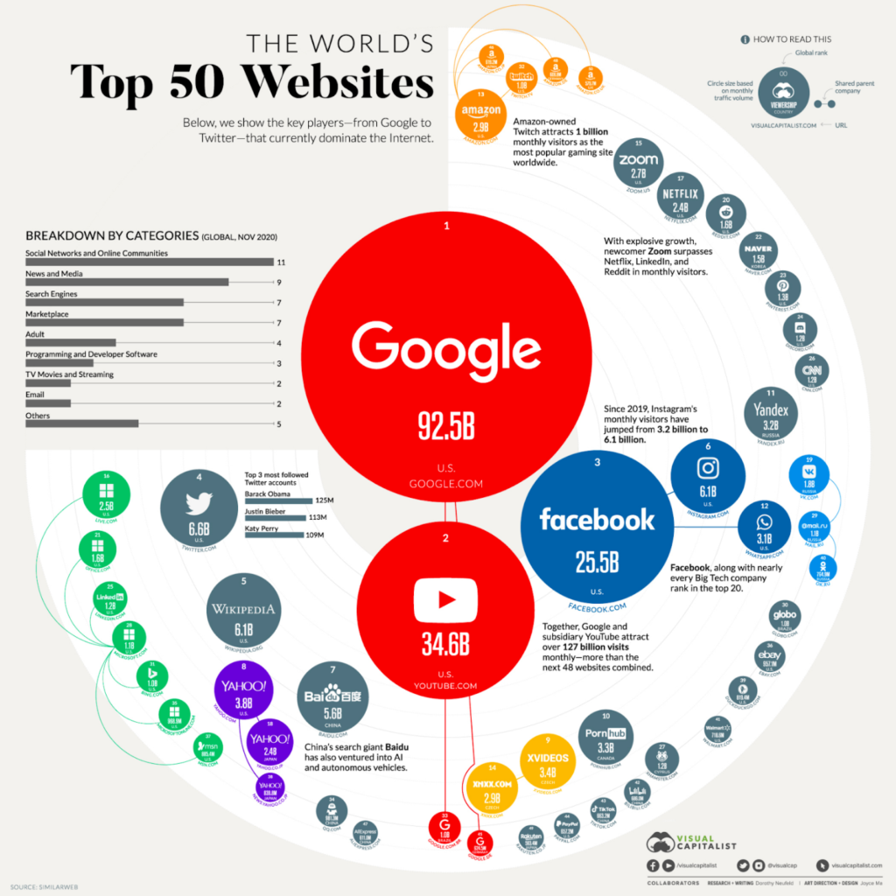
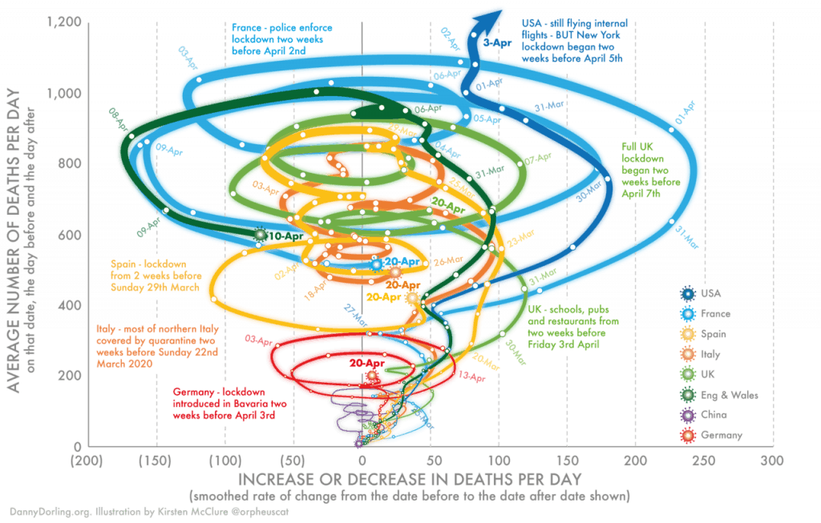
Data Visualizations
Good: Bad:
Image Source: Fragapane, Riccardo. “25+ Impressive Data Visualization Examples 2024.”
Image Source: Dunford, Christopher. “When Data Visualization Really Isn’t Useful (and When It Is).”

Slide 4
Problem
Given a dataset in $R^{d}$ with $d>3$, how do you effectively visualize the datapoints and similarity between groups of datapoints and study the shape of the dataset?

Slide 5
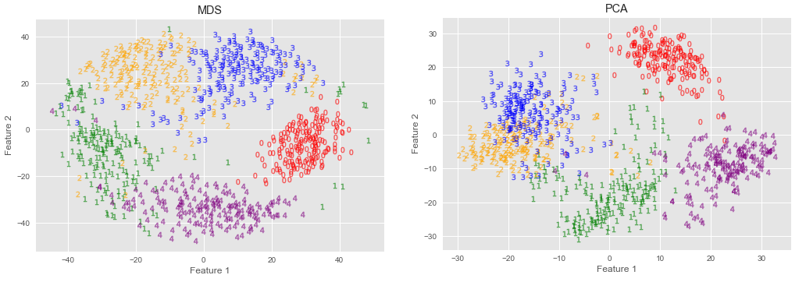
Some Approaches
Projection Pursuit Method⁴:
Finds a projection in “visualizable space” that is as useful as possible
Multidimensional Scaling⁵:
Place points into lower dimensional space such that pairwise distances are nearly preserved
PCA:
Visualize using first 2 principle components
Image Source: Kovan, Ibrahim. “Multidimensional Scaling (MDS) for Dimensionality Reduction and Data Visualization.”

Slide 6
What is Topology?
Given a set $X$, a topology $τ⊂P(X)$ is a collection of sets satisfying:
$X, φ∈τ$
$∀S⊂X$ such that $\left|S\right|<∞$, $\bigcap_{V∈S}{V}∈τ$
$∀S⊂X$, $\bigcup_{V∈S}{V}∈τ$
The sets in $τ$ are called open sets
Complements of open sets are called closed sets
Image Source: How can a mug and a torus be equivalent if the mug is chiral.

Slide 7
Standard Topology on $R^{n}$
For $R$, open sets are unions of open intervals
e.g. $\left(0,1\right)∪(2,3)$
For $R^{n}$, $n<∞$,open sets are unions of open balls
e.g. $B_{d}(0, 0.5)$

Slide 8
What is Topological Data Analysis (TDA)?
Analyze topological and geometric structure of datasets
Image Source: Talebi, Shawhin. “Topological Data Analysis (TDA)”

Slide 9
Simplicial Complex: Motivation
Traditional: Draw an edge between nearby points (think graph)
Next Step: edges between pairs and longer tuples of points (think high dimensional graph)

Slide 10
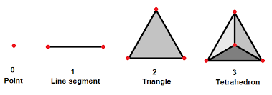
Simplicial Complex: Definitions
Defn: for a set $X= \left(x_{0}, x_{1}, …, x_{k}\right)$of affinely independent points in $R^d$, the k-simplex $σ=[x_{0}, x_{1}, …, x_{k}]$ is the convex hull of $X$
the points of $σ$ are called vertices and the simplices made from subset of $X$ are called faces of $σ$.
Image Source: Schneider, Jonathan. “Geometry of Simplices.”

Slide 11
Simplicial Complex: Definitions
Defn: A geometric simplicial complex $K$ is a set of simplices in $R^{d}$ such that 1. All faces of simplices of $K$ are simplices of $K$ 2. For all $σ_{1}, σ_{2}∈K$, $σ_{1}∩σ_{2}≠φ →σ_{1}∩σ_{2}∈K$
Defn: the union of all $σ∈K$ is called the underlying space of $K$

Slide 12
Simplicial Complex: Definitions
Defn: An Abstract Simplicial Complex $\tilde{K}$ with vertex set $V$ is a set of finite subsets of $V$ such that for all $σ∈\tilde{K}$and every nonempty $σ^{′}⊂σ$, $σ^{′}∈\tilde{K}$. We say $\dim\left(\tilde{K}\right)=\left|\tilde{K}\right|−1$

Slide 13
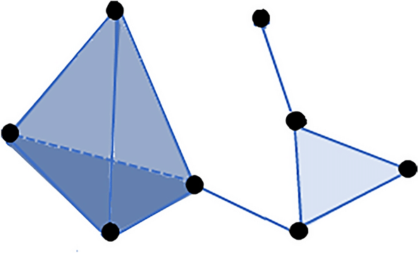
Simplicial Complex
Note: you can associate a topological space $K′$ to any abstract simplicial complex $\tilde{K}$
Image Source: Zampieri, et al. “A hands-on tutorial on network and topological neuroscience”

Slide 14
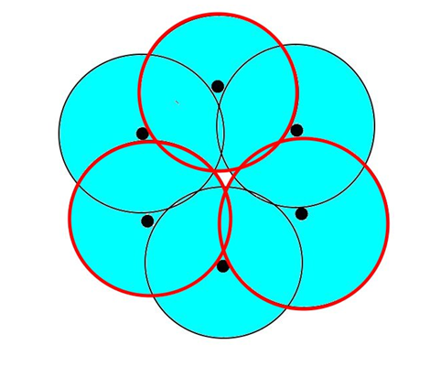
Building Complices
Cech Complex: given a dataset $\left\{x_{0},x_{1},…, x_{k}\right\}=X$, $Cech_{α}(X)$ consists of subsets $C=\left\{y_{1},y_{2}, …, y_{m}\right\}⊂X$ such that $⋂B\left(y_{i},\frac{α}{2}\right)≠φ$
Why is this important?
Image Source: Doherty, Brandon. “The Cech complex in Topological Data Analysis.”

Slide 15
Homotopy Equivalence
Defn: continuous maps $f_{1},f_{2}:X→Y$ are homotopic if $∃$ continuous map $H:X×\left[0,1\right]→Y$ such that $∀x∈X, H\left(x,0\right)=f_{1}\left(x\right) \text{and} H\left(x,1\right)=f_{2}(x)$
Defn: topological spaces $X,Y$ are homotopy equivalent if there exist continuous $f:X→Y$, $g :Y→X$ s.t. $f⊙g$, $g⊙f$ are homotopic to the identity maps on $Y,X$

Slide 16
The Nerve Theorem
Defn: Given a set $X$, a cover $𝒜$ of $X$ is a collection of sets such that $X⊂\bigcup_{V∈𝒜}{V}$
Defn: Given any cover $𝒜$ of $X$, the nerve of $𝒜$ is the simplicial complex C$(𝒜)$ satisfying $σ=\left[A_{i_{1}}, A_{i_{2}}, …, A_{i_{k}}\right]∈C(𝒜)$ iff $∩{A_{i}}_{j}≠φ$
Defn: $X$ is contractible if it is homotopy equivalent to a point

Slide 17
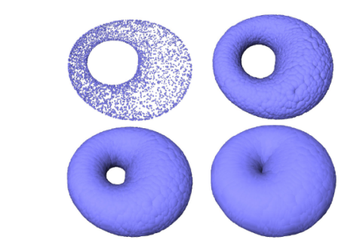
Nerve Theorem
Let $𝒜$ be an open cover of $X$ such that the intersection of any $B⊂𝒜$ is either empty or contractible. Then $X$ and $C(𝒜)$ are homotopy equivalent
Image Source: Chazal and Michal, “An Introduction to Topological Data Analysis”

Slide 18
Mapper Algorithm
Image Source: Talebi, Shawhin. “The Mapper Algorithm”

Slide 19
Example
Data: Daily price changes for stocks in the S&P 500 from January 2020- April 2022
Source: Talebi 2022
Visualization:

Slide 20
Conclusion
The mapper algorithm effectively visualizes relationships between high dimensional datapoints
It also builds simplicial complices to use in further analysis
Death by hyperparameters + user specs

Slide 21
References
Chazal, Frédéric, and Bertrand Michel. “An Introduction to Topological Data Analysis: Fundamental and Practical Aspects for Data Scientists.” Frontiers in Artificial Intelligence, vol. 4, 29 Sept. 2021, https://doi.org/10.3389/frai.2021.667963. Accessed 21 Apr. 2022.
Doherty, Brandon. “The Cech complex in Topological Data Analysis.” University of Western Ontario, May 24, 2018. Powerpoint
Kelleher, Casey and Pantano, Alessandra. “INTRODUCTION TO SIMPLICIAL COMPLEXES.” Princeton University, Lecture Notes
Friedman, J.H., and J.W. Tukey. “A Projection Pursuit Algorithm for Exploratory Data Analysis.” IEEE Transactions on Computers, vol. C-23, no. 9, Sept. 1974, pp. 881–890, https://doi.org/10.1109/t-c.1974.224051. Accessed 8 Dec. 2019.‌

Slide 22
References
Kovan, Ibrahim. “Multidimensional Scaling (MDS) for Dimensionality Reduction and Data Visualization.” Medium, 15 Oct. 2021, towardsdatascience.com/multidimensional-scaling-mds-for-dimensionality-reduction-and-data-visualization-d5252c8bc4c0.‌
Singh, Gurjeet, et al. “Topological Methods for the Analysis of High Dimensional Data Sets and 3D Object Recognition.” Symposium on Point Based Graphics, Jan. 2007.‌
Talebi, Shawhin. “The Mapper Algorithm.” Medium, 22 Dec. 2022, medium.datadriveninvestor.com/the-mapper-algorithm-d0842f926658.
Wan Rosli, Muhammad Hafiz, and Andreas Cabrera. “Application of Gestalt Principles to Multimodal Data Representation.” Proceedings of the IEEE VIS 2014 Arts Program, 9 Nov. 2014.

Slide 23
References
Weisstein, Eric W. "Polytope." From MathWorld--A Wolfram Web Resource. https://mathworld.wolfram.com/Polytope.html

Slide 24
Image Sources
Chazal, Frédéric, and Bertrand Michel. “An Introduction to Topological Data Analysis: Fundamental and Practical Aspects for Data Scientists.” Frontiers in Artificial Intelligence, vol. 4, 29 Sept. 2021, https://doi.org/10.3389/frai.2021.667963. Accessed 21 Apr. 2022.
Dunford, Christopher. “When Data Visualization Really Isn’t Useful (and When It Is).” Old Street Solutions, 13 Apr. 2023, www.oldstreetsolutions.com/good-and-bad-data-visualization.
Doherty, Brandon. “The Cech complex in Topological Data Analysis.” University of Western Ontario, May 24, 2018. Powerpoint
Fragapane, Riccardo. “25+ Impressive Data Visualization Examples 2024.” Maptive, 21 Dec. 2023, www.maptive.com/data-visualization-examples-2024/.
‌
.

Slide 25
Image Sources
How can a mug and a torus be equivalent if the mug is chiral. “How Can a Mug and a Torus Be Equivalent If the Mug Is Chiral?” Mathematics Stack Exchange, 30 Apr. 2017, math.stackexchange.com/questions/2258389/how-can-a-mug-and-a-torus-be-equivalent-if-the-mug-is-chiral.
Kovan, Ibrahim. “Multidimensional Scaling (MDS) for Dimensionality Reduction and Data Visualization.” Medium, 15 Oct. 2021, towardsdatascience.com/multidimensional-scaling-mds-for-dimensionality-reduction-and-data-visualization-d5252c8bc4c0.
Schneider, Jonathan. “Geometry of Simplices.” MATH 300, Department of Mathematics, UIC, Chicago. Course Notes.
Talebi, Shawhin. “The Mapper Algorithm.” Medium, 22 Dec. 2022, medium.datadriveninvestor.com/the-mapper-algorithm-d0842f926658.

Slide 26
Image Sources
Talebi, Shawhin. “Topological Data Analysis (TDA).” Medium, 1 Apr. 2023, towardsdatascience.com/topological-data-analysis-tda-b7f9b770c951.
Zampieri, Eduarda & Moreni, Giulia & Vriend, Chris & Douw, Linda & Santos, Fernando. (2022). A hands-on tutorial on network and topological neuroscience. Brain Structure and Function. 227. 10.1007/s00429-021-02435-0.

