Slide 1
Commonsense Abductive Reasoning
Joseph Cotnareanu
Supervised by Mark Coates

Slide 2
Introduction
LLMs hallucinate and are unfaithful
Logic is rigorous & exact
Why don’t we replace the LLM with logic solvers?
Logic solvers are too exact! Without a complete input, they are helpless.

Slide 3
Example: children’s reading comprehension
Animals must survive.
The arctic fox is brown in the summer. His coat turns white in the winter.
True or False: The arctic fox’s coat turns white in the winter because white absorbs the sun and is warmer.
Even with a perfect logical translation, a logic solver can never hope to solve this!

Slide 4


Abductive Reasoning
Abductive reasoning:
given problem context $P$ and a query proposition $Q:$
find some logical propositions $C$ that allow the correct logical deduction of $Q$
“and”
“guarantees”

Slide 5
The Nuance
If we abduct false propositions in C then we risk deducing the wrong value for the query Q
If we abduct irrelevant propositions in C then we never get anywhere
If we abduct relevant and true propositions in C then we’re happy

Slide 6
How can LLMs help?
LLMs are (imperfect) bases of commonsense
When the logic problem is grounded in commonsense, LLMs can help

Slide 7
A different perspective
Most work (including our last project) assumes a monolithic commonsense:
“a proposition P is either commonsensical or not”
“no two commonsensical propositions are contradictory”
“if we could write out every single commonsense premise, we could solve all commonsense abductive logic”
Is this really a fair assumption to make?

Slide 8
Example: movie recommendation
Which movie from the below options is most similar to the movies Schindler’s List, Braveheart, the Silence of the Lambs and Tombstone?
Orlando
Guilty of Romance
Forrest Gump
All The Real Girls
On which basis do we consider similarity
by date, by genre, by actors, by subject matter, etc…

Slide 9
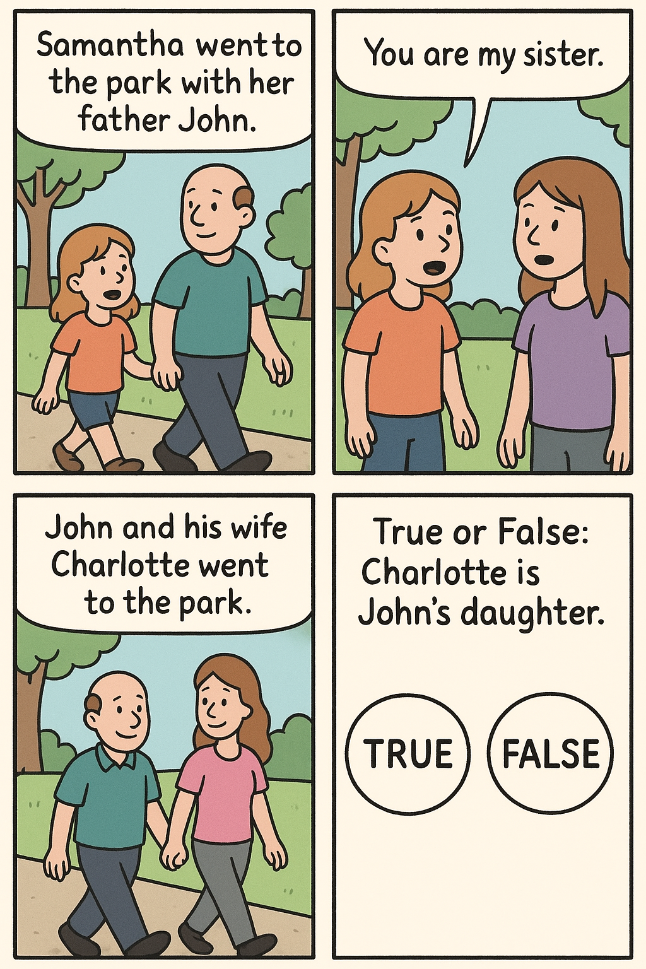
Example: relational reasoning
“Samantha went to the park with her father John.
Samantha said to Charlotte “You are my sister”.
John and his wife Charlotte went to the park.
True of False: Charlotte is John’s daughter.”
*ai generated image

Slide 10
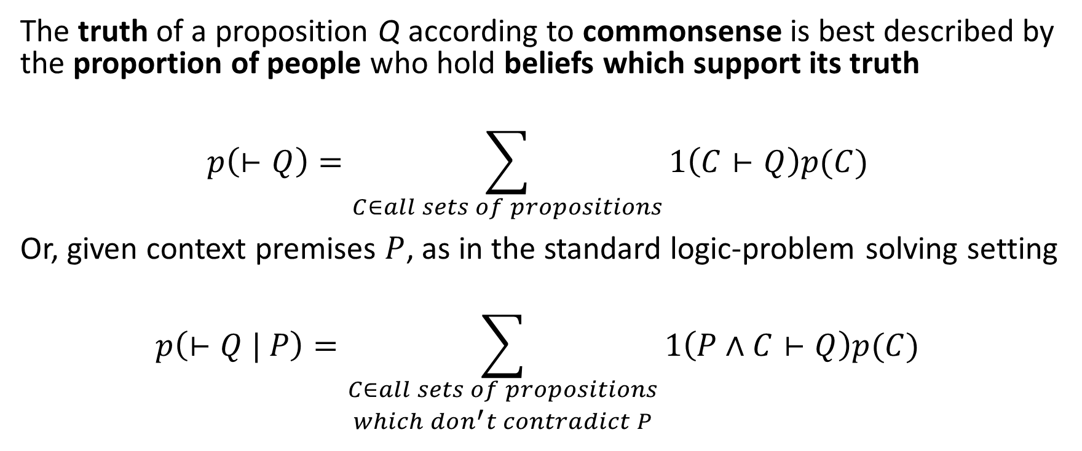
Our claim
The truth of a proposition Q according to commonsense is best described by the proportion of people who hold beliefs which support its truth
$$p\left(⊢Q\right)={\sum_{C∈all sets of propositions}{1\left(C⊢Q\right)p(C)}}_{ }$$
Or, given context premises $P$, as in the standard logic-problem solving setting
$$p\left(⊢Q | P\right)={\sum_{\begin{aligned}C∈all sets of propositions \\ which don^{′}t contradict P\end{aligned}}{1\left(P∧C⊢Q\right)p(C)}}_{ }$$

Slide 11
Some parallels in the literature
(weighted) model counting
describe a probabilistic system in terms of logic, count the number of variable assignments which entail Q vs not Q
Self-Consistency
prompt an LLM many times with the same reasoning problem and count the number of times the LLM concludes each choice

Slide 12
So, the problem is modelling/sampling
How can we (better) model/sample C?

Slide 13
I don’t know…
do you?

Slide 14
Naïve model counting
What if we assume C is uniform.
Then, given the input logic, we can just model count the query.
Surely adding random constraints to our logic will yield random performance, right?
Actually, this kind of works
(but not that well)

Slide 15
Some other ideas we’re looking into
Learn to model p(C) in latent space using LLMs as feature-engineers
Scoring individual steps in a COT by the change in model count
“if a step eliminates lots of options for C which entail one choice, then it’s useful (but maybe incorrect)”
“if a step eliminates lots of options for C which entail the incorrect choice, then it’s useful and correct”
Cross-sample abduction consistency
how often do samples of C for the same P include the same propositions

